Slide 1
LANGUAGE
AND
COMMUNICATION
CIRCLE

Slide 2
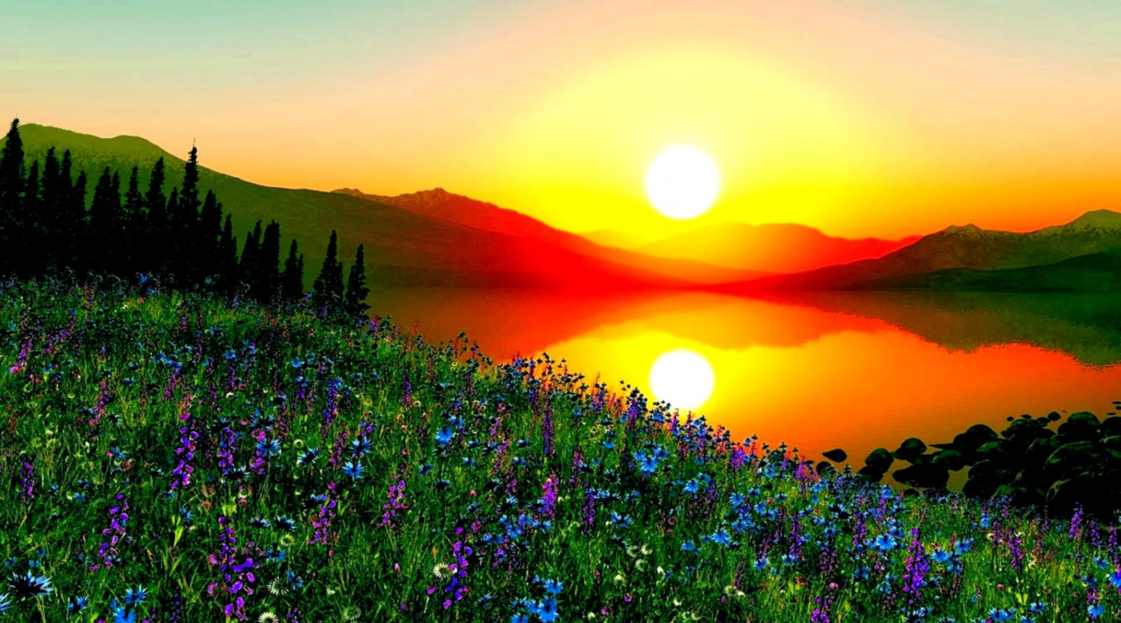

W E L C O M E

Slide 3
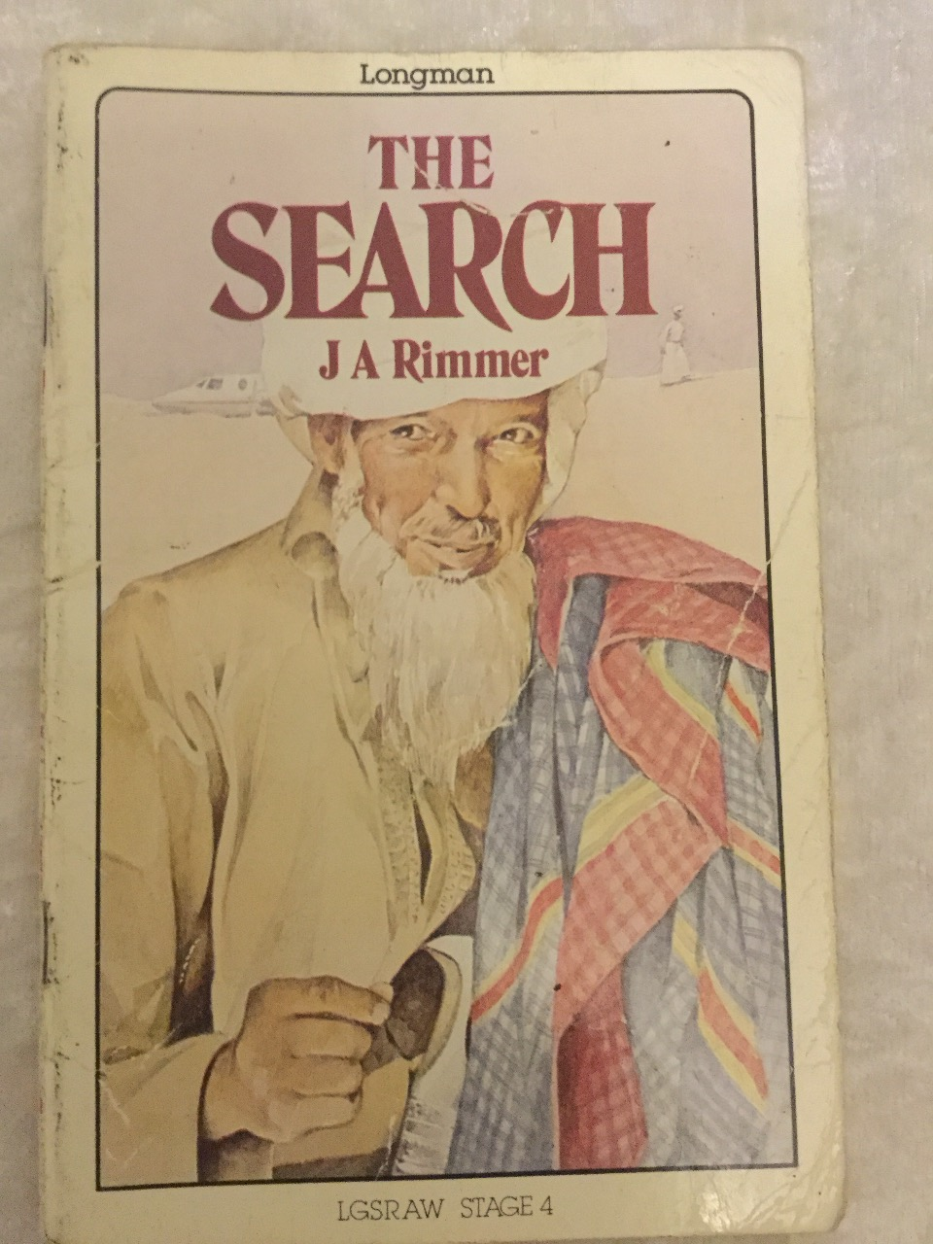
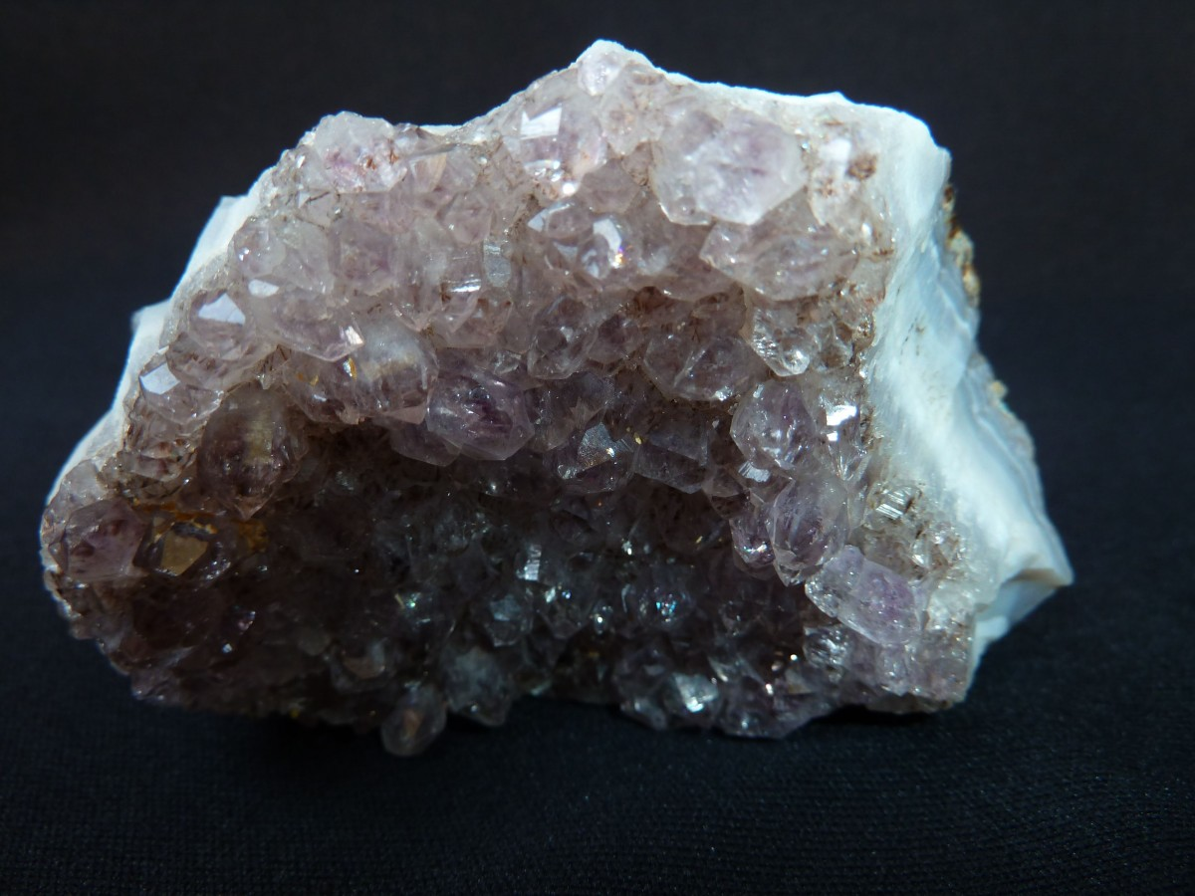
What is the
most vauable thing in the world ?
Five Arab children travelling on a plane that had to land in the desert were rescued by the Beduin.
While they were waiting for help , old Abu Khalid told them of a young man’s search for the answer to the above question.
Before they returned to the modern world, the children learnt much about the Beduin and about the traditional Arab values that guided them in their daily lives.

Slide 4
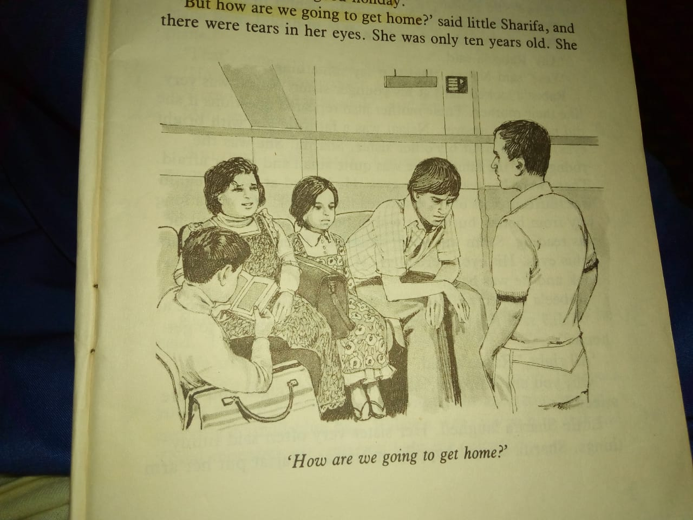
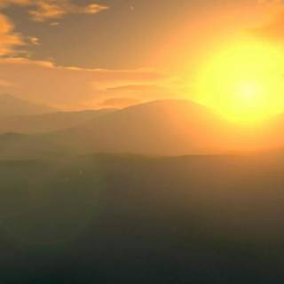
“ Well, we saw Egypt,” said Hamad.
“Yes. We saw Cairo and the River Nile, too.”
“ And the shops as well,” said Najaat.
“ I liked the shops,” little Sharifa added.
“ It was a good holiday,” said Hamad.
“ But how are we going to get home?” said little Sharifa.
There were tears in her eyes. She was only ten years old. She looked at her elder brother Hamad. Najaat, Suleiman and Salim looked at Hamad, too.
There were five in the family: three boys and two girls. Hamad was the oldest. He was seventeen.
They all looked at him. He looked at them.
CHAPTER ONE
In The Beginning

Slide 5
“Well,” said Najaat, “How are we going to get home?”
“ Oh, we will get home all right,” said Hamad.
“ Of course we will,” said Suleiman. Suleiman was fifteen. He was not as tall as Hamad, but he had grown quickly since his fifteenth birthday.
“ But how?” asked Najaat.
Hamad looked hard at his younger sister. Najaat was very much like their mother. She repeated questions
if she did not get an answer. She was a fat little girl with bright eyes.
He looked at his other sister, Sharifa. She was the youngest of the family. She was quite small and rather afraid. There were big tears in her small eyes.
He looked at Salim. Salim was thirteen. He was reading a book. He was a long way from home, but he sat with a book in his hand. Salim was never troubled. He was happy reading his book.
Hamad looked at Suleiman. Suleiman looked at Hamad.
“ Well?” said Najaat. “ Come on! How are we going to get home?”
“ All right,” Hamad said. “ I am thinking.”
“ Oh, you are thinking,” said Najaat. “ I thought you were asleep.”
Little Sharifa laughed. Her sister very often said funny things. Najaat put her arm round Sharifa. They both laughed. Even Salim looked up from his book. Suleiman looked at Hamad . They laughed.
“ All right, all right,” said Hamad, “have a good laugh. Now listen to me. Here we are in Jeddah. We have missed the plane for Muscat. Does it matter? People miss planes everyday.”
“ We do not,” said Najaat. “ We have not travelled by plane before.”

Slide 6
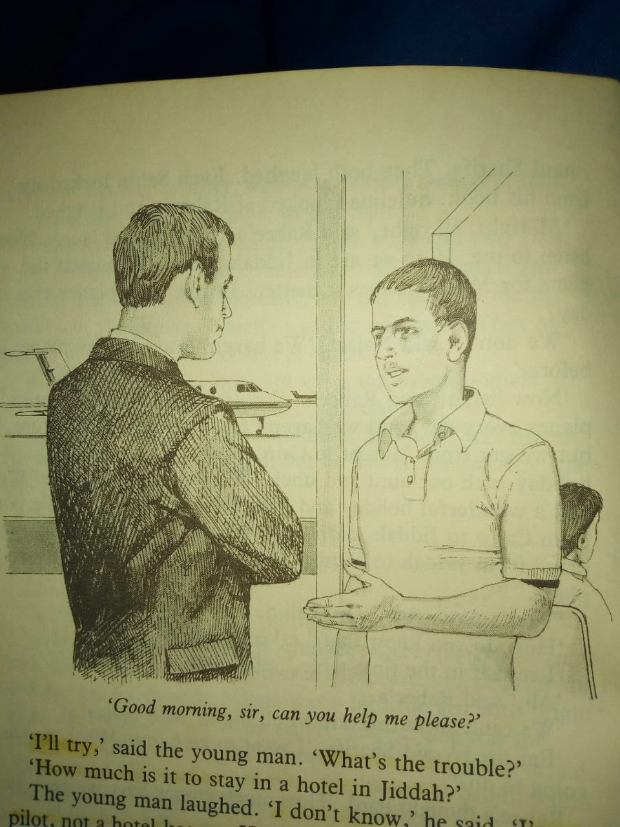
Hamad walked across the airport waiting room. He saw a young man who was wearing a blue coat and trousers and carrying a small blue bag.
He went up to him and said, “ Good morning, Sir. Can you help me, please?”
“ What is the trouble?” the young man asked.
“How much is it to stay in a hotel in Jeddah?” Hamad asked. The young man laughed. “ I do not know,” he said. “ I am a pilot, not a hotel-keeper. But…hotels are expensive here.” “ Are you here on holiday?” he asked.
“ Our holiday is over. We are trying to get home now,” replied Hamad.
“ Now, listen,” said Hamad. “ You are right. We do not miss planes everyday, and we have not travelled by plane before. But we got from Muscat to Cairo safely. We had a good holiday with our aunt and uncle. We saw the River Nile. We came from Cairo to Jeddah. And now we have missed the plane from Jeddah to Muscat. All right. We will catch the next plane.”
“ Tomorrow,” said Salim.
“ How do you know?” asked Hamad.
“ I read it in the time-table,” replied Salim.
“ But we can not sit here in the airport all night!”, said Najaat.
“ I am tired,” said Sharifa. “ I want to go home. What are we going to do now?”
Hamad thought hard. “ Let us see how much money have we got,” he said.
He did some counting. “ We have got 35 Rials. I will ask somebody about a cheap hotel. Wait here,” he said.

Slide 7
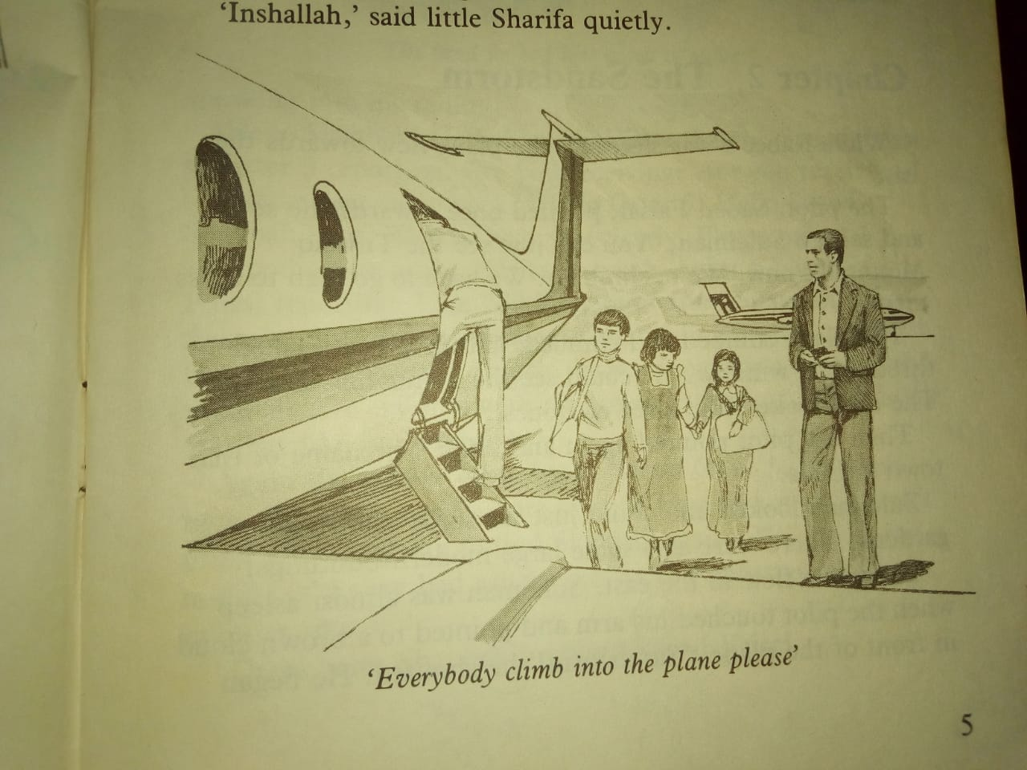
“WE?” wondered the young pilot.
“ Yes. Myself, my two brothers and my two sisters.”
“ M’m,” said the pilot. “ Five of you…that is going to cost a lot if you stay at a hotel! Where is your home?” “ Muscat,” answered Hamad.
“ Ah,” said the pilot, “ there was a plane to Muscat only an hour ago. Why didn’t you take it? What happened?”
“ We just missed it,” said Hamad.
“ I think I can help you”, said the young pilot. “ I’m going to fly a plane to Muscat today. It is only a small plane, but it’s big enough to take you five. Go back to join your brothers and sisters and wait for me. I must make a phone call. I’ll come back in a few minutes.”
A few minutes later, the young pilot came back to the waiting room and waved to Hamad.
“ Come on, boys and girls, I think he is going to help us,” said Hamad.
They picked up their bags and followed the young pilot out of the waiting room and across to a small plane with two engines.
“This is your chance,” said the pilot, “ I am flying this small plane to Muscat. We will stop at Shaybah on the way. I have some tools for the oil-men there. We will also get more petrol for the plane there and then we will continue our way to Muscat. You will be home this evening.”
“ Inshallah,” said little Sharifa quietly.
“ Right,” said the pilot “ everybody gets on board, please. Hurry up, please.”
He got into the pilot’s seat and said: “ My name is Saood Faysal and my home is in Qatar.”

Slide 8
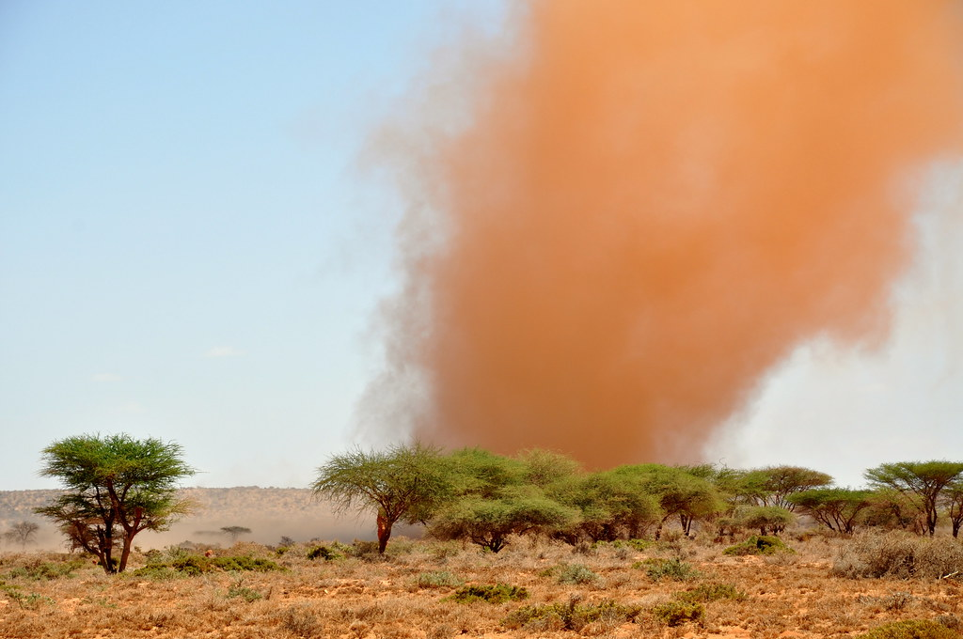
The pilot started the two engines and spoke
into his radio.
Then, the plane began to move towards the runway.
After a few minutes, the plane took off . It started to climb into the sky, away from Jeddah.
The children looked back. The airport now seemed very small as the plane climbed higher.
Hamad looked at his brothers and sisters in their seats. Everybody was comfortable. Sharifa was nearly asleep. Najaat was quiet. Suleiman was sitting next to the pilot. He was watching everything Saood was doing. Salim was reading.
Hamad felt very tired. He closed his eyes and fell asleep.
CHAPTER TWO
The Sandstorm

Slide 9
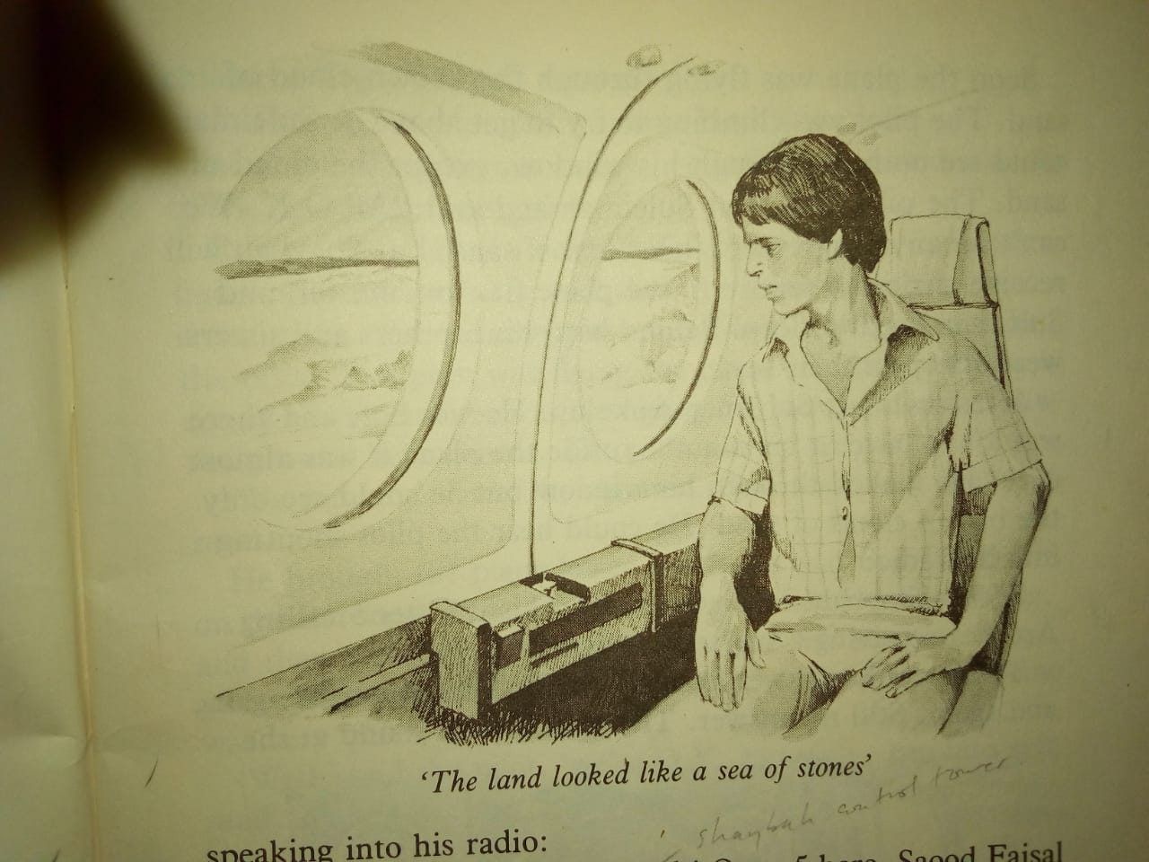
While Hamad was sleeping, the plane was flying to the east. The pilot, Saood Faysal, pointed once to the south and said to Suleiman, “ you can just see the Tuwaiq Mountains now. We are climbing. We have to go high to cross them.”
The plane climbed and climbed, and Suleiman kept looking through the window. He could see the mountains clearly. The land looked like a sea of stones.
Then the pilot pointed again and said, “the name of that town over there is Leila.” Suleiman could see just some water and gardens. There were also some large modern buildings there.
The plane flew to the east Suleiman was almost asleep when the pilot touched his arm and pointed to a brown cloud in front of the plane. “ Sandstorm!,” he shouted.
The pilot began speaking into his radio.
“ Hello Shaybah! Hello Shaybah! Otter 5 here. Saood Faysal in Otter 5 reporting. Are you receiving? Are you receiving?”
The answer came back: “ Hello Otter 5. Hello Saood. Shaybah here. We can hear you clearly. Please report.”
Saood spoke again: “ Hello Shaybah. Otter 5 here. Saood Faysal reporting. I am 700 km far. I am flying at 3000 metres. I hope to arrive in Shaybah in 2 hours’ time, at 3 o’clock. I have some tools for you and there are five children with me, going to Muscat. What is the weather like in Shaybah?”
Again the answer came back: “ Hello Otter 5. Shaybah here. We have made a note of your time of arrival. I don’t think you are going to find Shaybah easily. We are in the middle of a very bad sandstorm here. Report every 15 minutes, please.”
“ Thank you, Shaybah,” replied Saood Faysal.

Slide 10
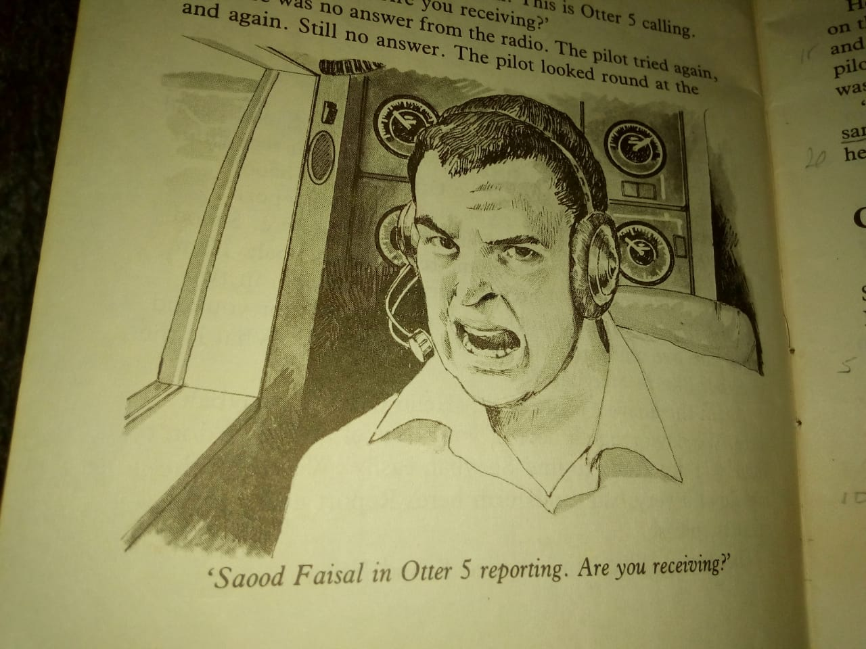
Soon the plane was flying through the brown cloud of sand. The pilot was climbing to try to get above it. Suleiman could see nothing through his window, except the cloud of sand. Saood smiled at Suleiman and said, “ ALL O.K. We cannot see anything except this cloud of sand, but Shaybah will receive our radio reports.”
The plane flew on and on. Suleiman tried to sleep. Behind him, his brothers and sisters were all asleep in their seats.
After an hour, Suleiman woke up. He was hot, and there was a bad taste in his mouth. It was almost dark inside the plane. He looked through his window, but he could see only the brown cloud of sand all around.
He could hear only the pilot shouting into his radio.
“ Hello Shaybah! Hello Shaybah! This is Otter 5 calling! Are you receiving? Are you receiving?”
There was no answer from the radio. He tried again
and again. Still no answer. He looked round at the children. They were all awake now.
“ I am sorry,” he shouted. “ I must land this plane somewhere. Please fasten your safety-belts. We are going down. Be quick now. Help the girls!”
The plane started to go down and down

Slide 11
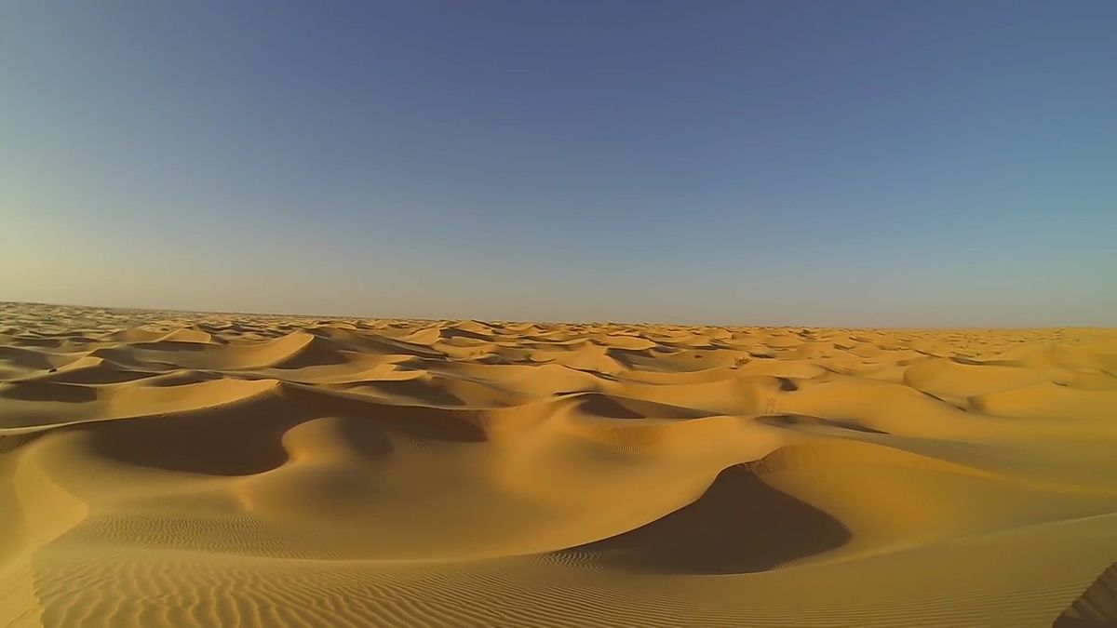
Suleiman kept watching the pilot. He was flying the plane carefully and the sound of the engines was changing.
All of a sudden, Suleiman saw the ground below them.
“ We can land here,” shouted the pilot. “I hope it is hard sand,” he added.
He brought the plane lower and lower and then landed it on the flat sand. The plane ran along the sand rather noisily, and then suddenly it turned to the right and stopped.
Saood quickly turned off the engines.
Everybody on the plane was quiet.
“ Well,” said Saood, “ we are O.K. But we have run into soft sand. We are really in trouble now. We cannot take off from here again.”
CHAPTER THREE
The Desert

Slide 12
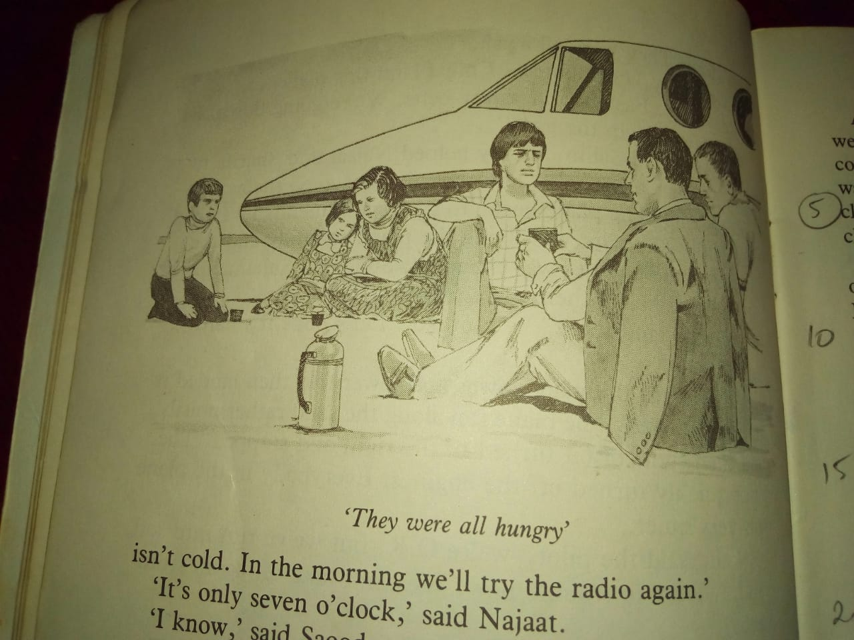
At 7 o’clock that evening, the sun had gone down. Saood and the children sat on the sand near the plane. Najaat had her arm round Sharifa. Sharifa had stopped crying. The night was very dark. They had all drunk some coffee. Saood had brought it in the plane. They were all hungry. But, there was no food. “ We will all be thirsty soon,” said Saood. He tried to speak to Shaybah by radio on the plane several times. But each time there was no answer.
“ Well, boys and girls”, he said. “ I think we can get a good night’s sleep here on the sand. If you like you can sleep inside the plane, but you can lie down comfortably on the sand in the open. The sand isn’t cold. We will try the radio again in the morning.”
“ It’s only seven o’clock. It’s too early to go to bed,” said Najaat.
“ Let’s tell stories,” said Salim.
“ All right,” said Saood. “ Tell us about the book you were reading in the plane.”
Salim told them about the book. Saood also told them about his home in Qatar, and about his training as a pilot. Soon, Najaat noticed that Sharifa had fallen asleep. Suleiman was sleeping, too. Najaat lay down. Above her in the black sky thousands of stars shone brightly. Her brother, Hamad, also lay looking at the stars. He thought about his mother and father in Muscat. His father would be angry with him. His mother would be crying. He felt very sad, but he, too, fell asleep. Soon everyone was sound asleep. During some time in the night, Salim woke up and could hear the pilot trying the radio in the plane again.

Slide 13
At four o’clock in the morning, everyone was awake. They were all very cold.
Saood gave the children the last of his coffee. They all got up and walked round the plane to get warm. The children opened their bags and put on more clothes as there was a chill in the air. The boys gave some of their clothes to their sisters.
When the sun began to rise and they could see each other clearly, they started laughing. Sharifa pointed to Najaat. Her sister had tied some of Hamad’s clothes round her body. Sharifa could not stop laughing.
As the sun rose higher, everybody began to feel warm. The children put their clothes back in their bags.
By eight o’clock, it was getting hot. They all sat in the shade of the plane. By eleven, it was very hot.
All around the plane, the Great Sands of
the Rub Elkhali were flat as far as the eye could see.
Saood tried the radio every hour, but got no answer.
At midday, he made the children put more clothes round their heads. All around them, the sand grew hotter and hotter in the sun. The heat hammered them. The plane was too hot to touch.
Saood looked carefully at the little girl, Sharifa. She seemed to be sleeping again.
“ Is she still breathing?” he asked himself. He looked more closely. She opened her eyes and looked back at him.
“ I’m thirsty,” she said.

Slide 14
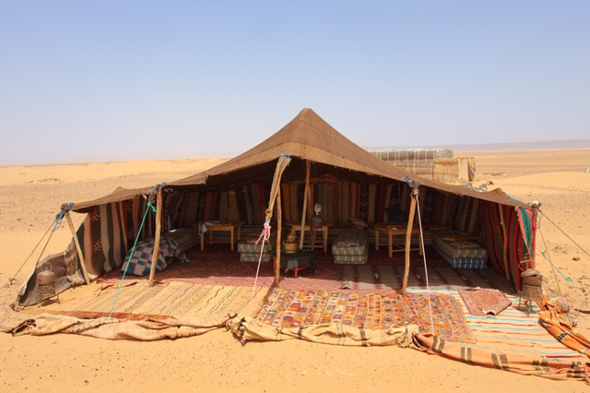
All that afternoon, the children sat or lay under the plane in the great heat. They dreamt about fruit and drinks.
Suleiman dreamt about dozens of oranges in front of him. He chose a big, fat one and put out his hand to pick it up. There was nothing there, only hot sand.
His brother, Hamad, thought he could see glasses of cold water in front of him. There was ice in each glass.
He could hear the ice moving in the glasses. Then, he opened his eyes painfully. There was no water there. Only hot sand.
Salim, the youngest brother, tried to read. But he could hardly see the words. He felt very tired. He left his head and looked across the Great Sands. Something was moving in the distance. Small black shapes seemed to be dancing in the air.
CHAPTER FOUR
The Beduin

Slide 15
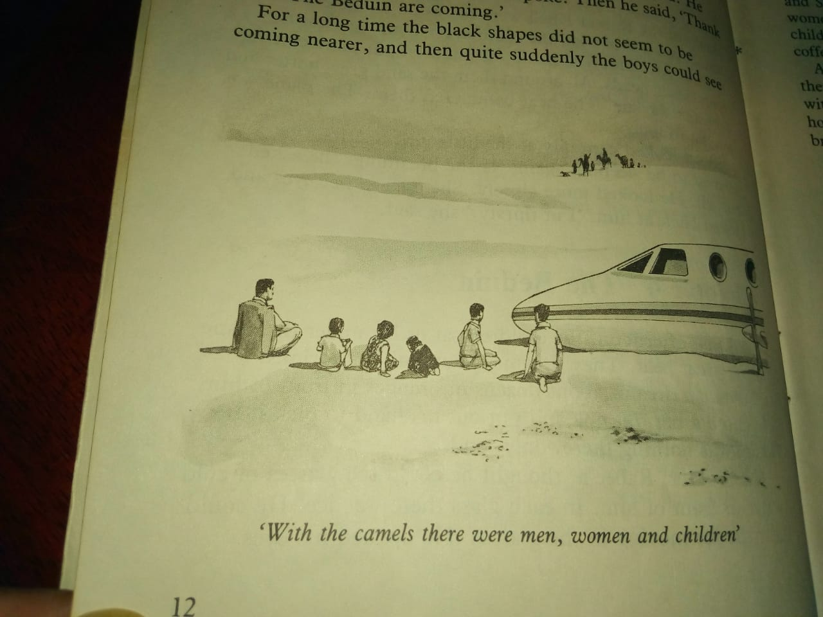
He watched them for some time, and then closed his eyes. After a few minutes, he looked again. The small black shapes were still there. They seemed to grow bigger.
He touched Hamad on the arm and said: “ Look!”
Hamad looked and then looked again.
“ Something is coming,” he said.
They woke up Saood. He had fallen asleep for the first time since the plane landed. He stood up and looked. He kept looking for a long time before he spoke.
“ Thanks Allah! The Beduin are coming towards us.”
For a long time, the black shapes did not seem to be coming nearer, and then quite suddenly the boys could see that the shapes were camels.
With the camels, there were men, women and children, some walking, some riding. There were also dogs with them. They came nearer and then stopped.
One of the men spoke, “ Assalaam Aleikoum.”
“ Wa aleikoum assalaam, “ Saood Faisal replied.

Slide 16
The Beduin got down from their camels and began putting up a tent.
They carried Sharifa and Najaat in the tent. Saood and the boys followed them.
Very quickly, the Beduin made sweet tea and started making bread. They gave Saood and the boys dates to eat and many cups of hot tea to drink.
The women were looking after the two girls.
Some of the Beduin children went to look at the plane. The man sat down drinking coffee from little cups, and smoking cigarettes.
After a while, they asked Saood about the plane. He told them about the sandstorm and the radio.
The men listened with interest. They asked Saood and the boys about their homes and families.
One of the men brought the newly-made bread and put it before them.
“ Welcome,” he said, “ Eat! Drink more tea!”
Another man said , “ We are Beduin of Al Murrah.”
“ You have good camels,” Hamad said, “ how many are there?” he wanted to know.
“ Very many,” said one Beduin man, “ and their milk is the best of all.”
By then, the sun had gone down, and it was getting dark.
The Beduin men got up and went to pray. The boys and Saood joined them.
Together, they knelt and prayed.
“ Allah is Great,” they said, “ Allahou Akbar.”

Slide 17
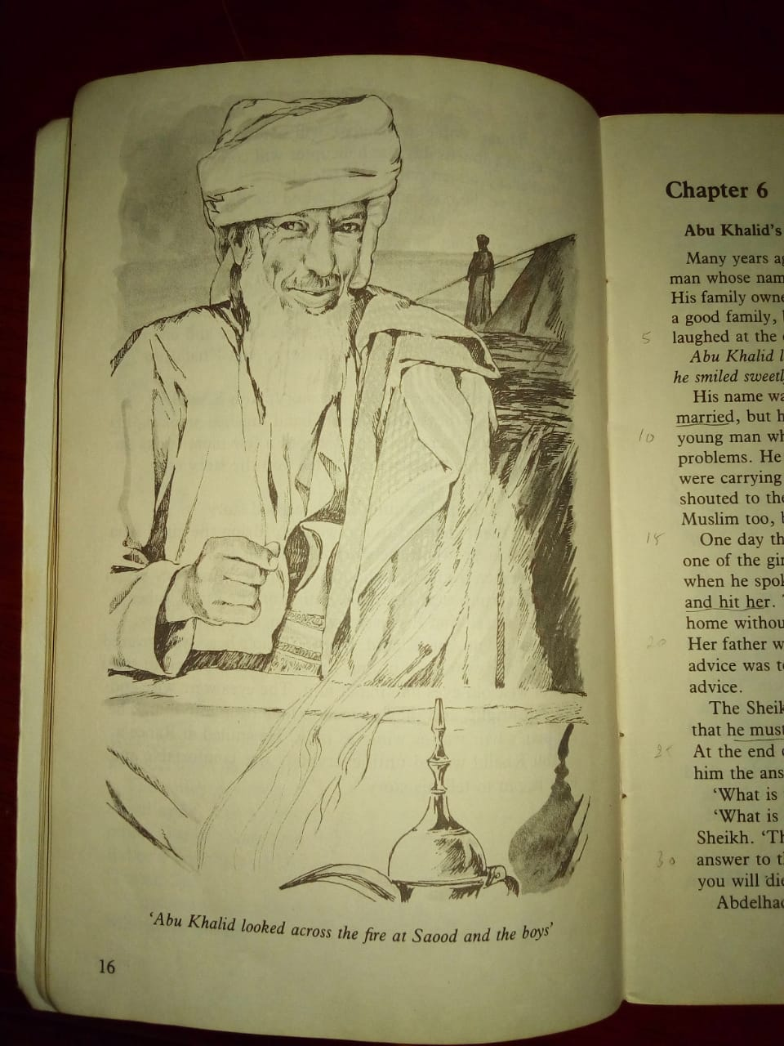
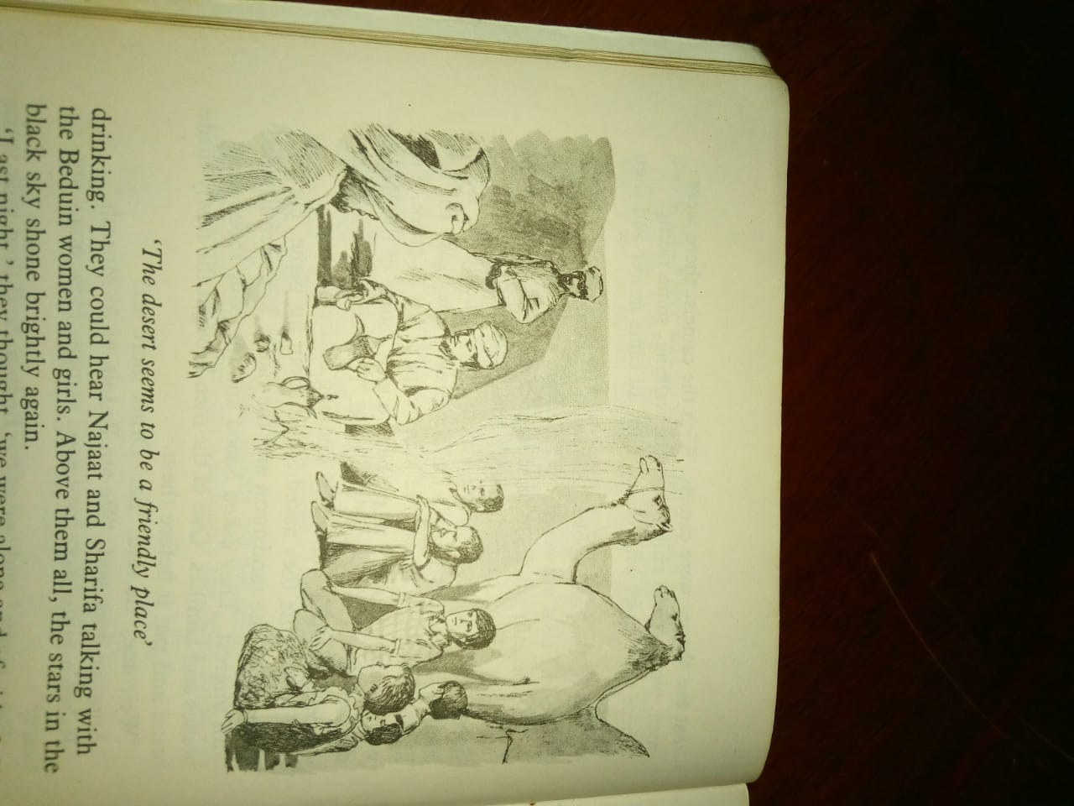
Later that evening, the boys and the pilot sat round a little fire and watched the Beduin making coffee.
The boys and Saood were feeling much better after eating and drinking. They could hear Najaat and Sharifa talking with the Beduin women and girls.
Above them all, the stars in the black sky shone brightly again.
CHAPTER FIVE
Abu Khalid

Slide 18
“ Last night,” they thought, “we were alone and afraid of the desert. This evening with the Beduin, the desert seems to be a friendly place.”
The camels were sitting down not far from the fire. Sometimes, the Beduin spoke to them, and the camels seemed to understand and answer.
The coffee was ready, and the little cups were passed round again. The Beduin smoked tobacco in their little pipes. One of them asked the boys whether they were well. Hamad said that everyone was well. The Beduin all said, “ Alhamdou Lillah.”
“ Tomorrow,” said one, “ early in the morning, some of us will ride to Shaybah. The journey will take three nights. Those people in Shaybah will send a helicopter for you. The helicopter will surely arrive on the fourth day.”
“ Inchallah,” added one of his friends.
For a time the boys and Saood asked the Beduin questions about their lives. They learnt that the Beduin love their life in the desert. They hate living in houses. They love to sleep in the open air under the sky and see the moon and stars above them. It is a hard life, but they love it.
The Beduin told the boys about the long journeys they make and the places they see.
After a time, they passed round more coffee.

Slide 19
One of them said to his friend, “ Tell us a story, Abu Khalid, to please our friends.”
“ Yes,” said the others, “ tell us a story, Abu Khalid.”
The old man they called Abu Khalid finished smoking his pipe, drank another cup of coffee, put a few more sticks on the fire, and then answered : “ I will tell you the story of Abdulhaqq, if you like.”
“ Good,” said the Beduin. “ That is a good story.”
One of them shouted to the women, “ Bring the girls! Abu Khalid is going to tell the story of Abdulhaqq.”
The women in the tent shouted, “ Coming!”
They began to form a group, sitting on the sand, near the old man.
Hamad was glad to see that his sisters were laughing and at ease. He looked at Abu Khalid.
The old man’s head was covered by a red and white cloth. Hamad was surprised to see a pair of wise old eyes looking at him. The eyes were wise and old, but bright, and they seemed to look deep into him.
The old man’s hair was as white as milk. He smiled at Hamad.
Abu Khalid waited until everybody was comfortable and then began to tell his story.

Slide 20
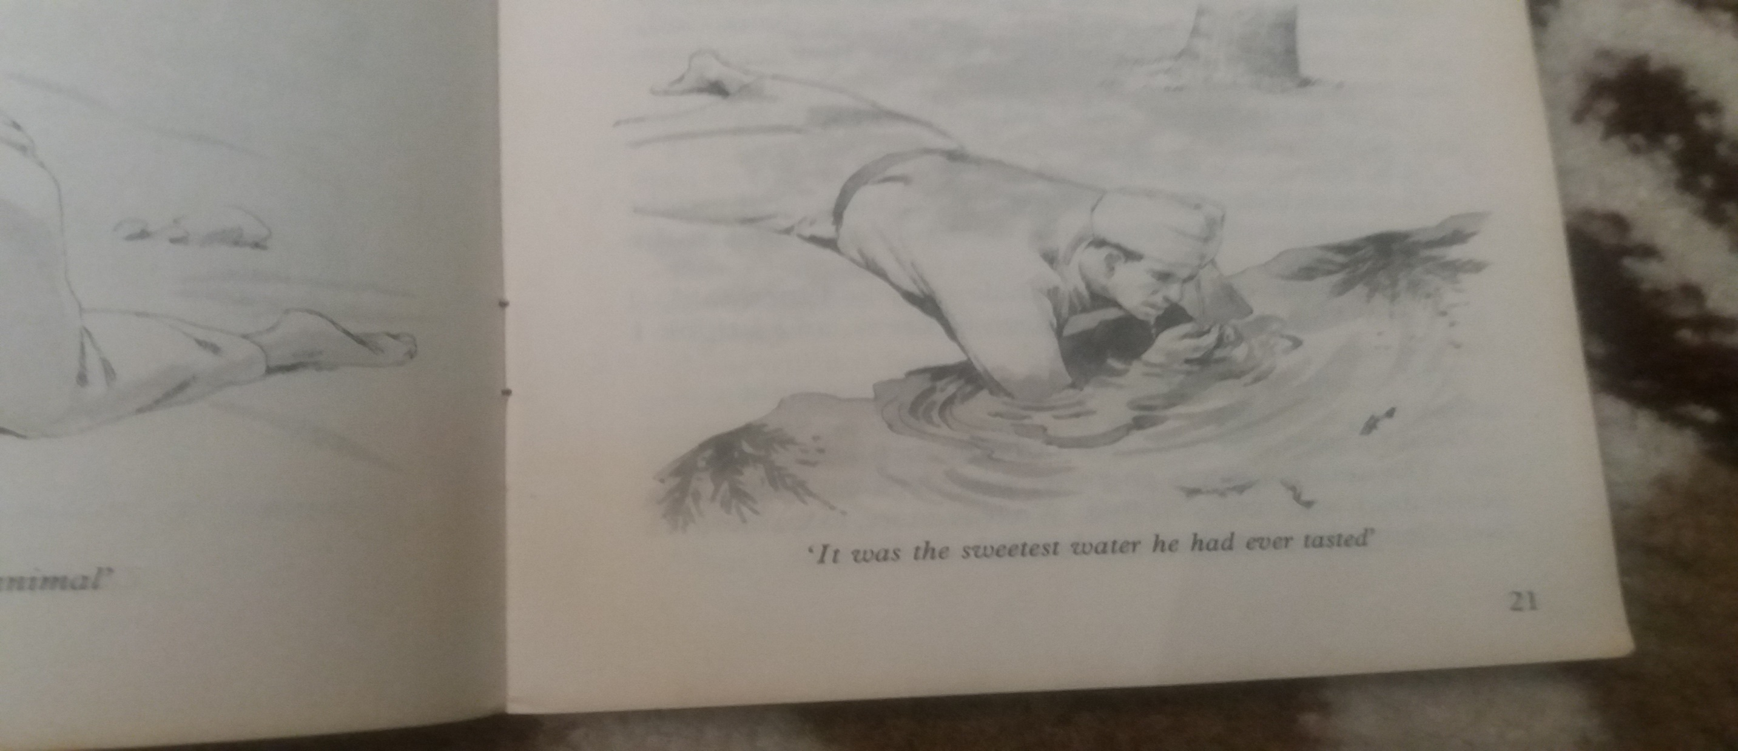
Abu Khalid’s story (1)
Many years ago, said old Abu Khalid, there was a young man whose name was Abdelhaqq. His home was in Haradh. His family owned some gardens and trees there. He was from
a good family, but like many young men,
he sometimes laughed at the old people and
their ways.
Abu Khalid looked across the fire at Saood and the boys, and he smiled sweetly.
CHAPTER SIX
Abdelhaqq

Slide 21
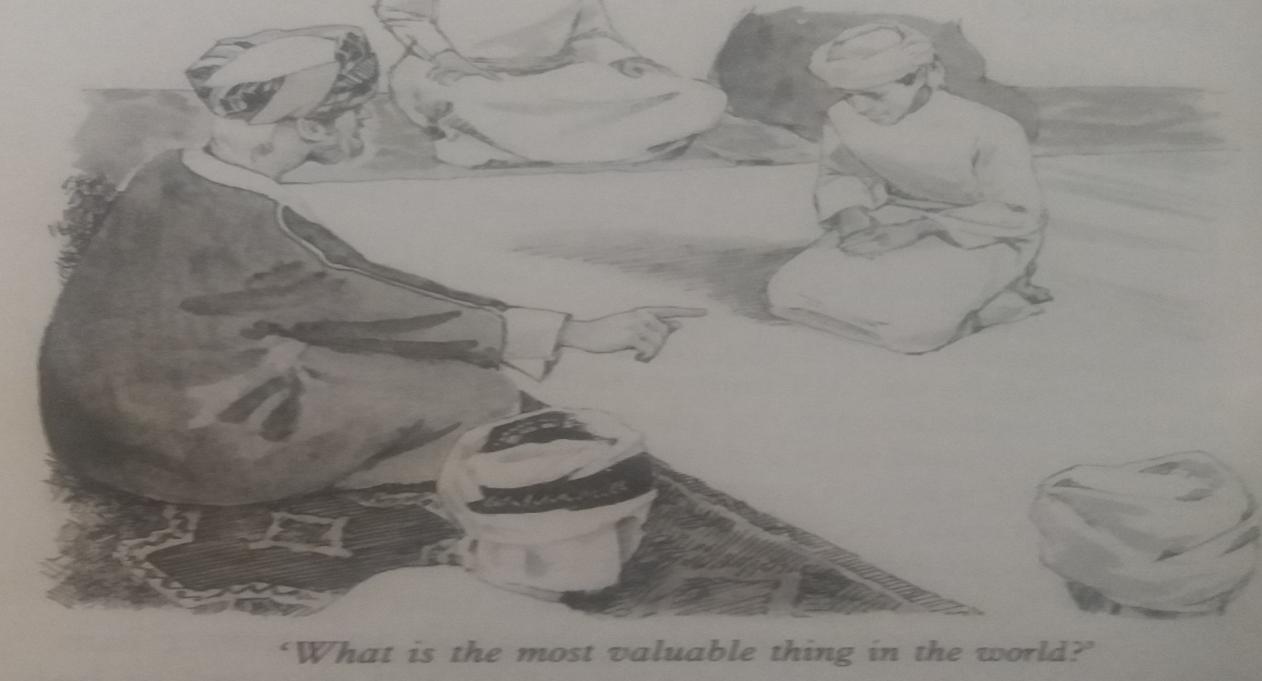
His name was Abdelhaqq, repeated the old man.
He was not married, but he was old enough to
do so. He was a young man who wanted the pleasure of life but not the problems. He used to watch the girls of Haradh when they were
carrying water to their homes, and sometimes
he shouted to them.
His father was a good man, and a good Muslim too, but Abdelhaqq was rude.
One day, this Abdelhaqq was waiting near
the well when one of the girls came to get water. She didn’t answer him when he spoke to her.
He became angry and shouted at her and hit her.
The girl was afraid, of course, and went back
home without water. She told her father about that. The father got furious. He was ready to kill the young man. However, her mother’s advice
was to speak to the Sheikh. It was good advice.
The Sheikh listened carefully to the story. He then
told Abdelhaqq to leave Haradh. He mustn’t
return for one year.
At the end of the year, when he comes back,
he must bring with him the answer to a question.
“ What is the question?” asked Abdelhaqq.
“ What is the most valuable thing in the world?” replied the Sheikh. “ You must bring me the right answer to this question. If you don’t, you will die
like an animal.”

Slide 22
One man said, “ You will find the answer to that
question by asking a wise man in the village called Teewi. His name is Omar Abdullah. Teewi is twenty days
journey across the Great Sands, so you must have a Beduin to guide you, and you must have good camels.”
Abdelhaqq decided to go to Teewi. He bought
three good camels and asked a Beduin guide
to travel with him.
His guide, Rashid, had visited Teewi two or
three years before. He said he knew the way.
A journey of twenty days across the Great Sands
is very dangerous, but the two men loaded
the camels and set out.
Abdelhaqq had to leave his home then. So, he
got ready to travel, said good-bye to his family,
and set out.
His mother cried, of course,
and his father was sad.
Abdelhaqq went first to Kuwait, then visited Basrah and followed the river up to Baghdad, and even went as far as Mosul in the north, then he returned south.
He had wasted a great deal of money, but he had not learnt much. But, he had begun to think about the question that he had to answer or die.
Sometimes, he had asked people. He received many different answers.
Some answered that it is gold. Others said money. Some said land. Others said camels.

Slide 23
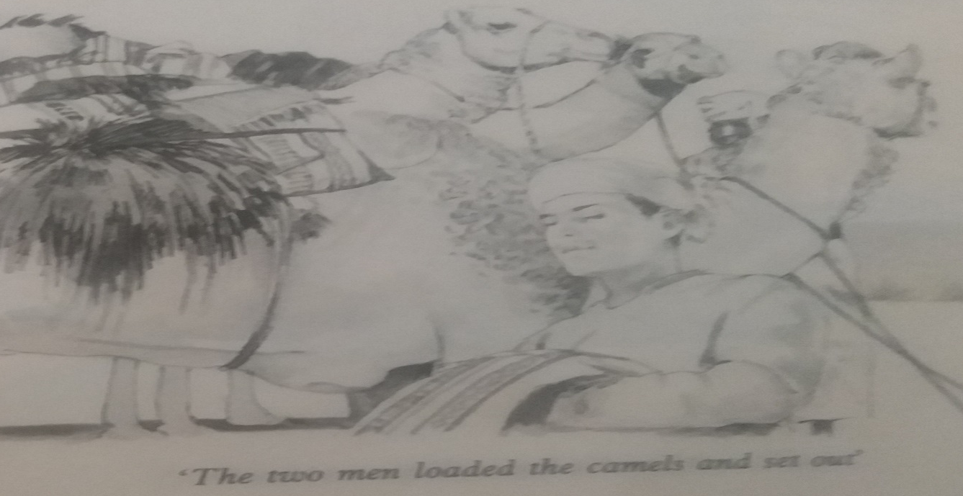
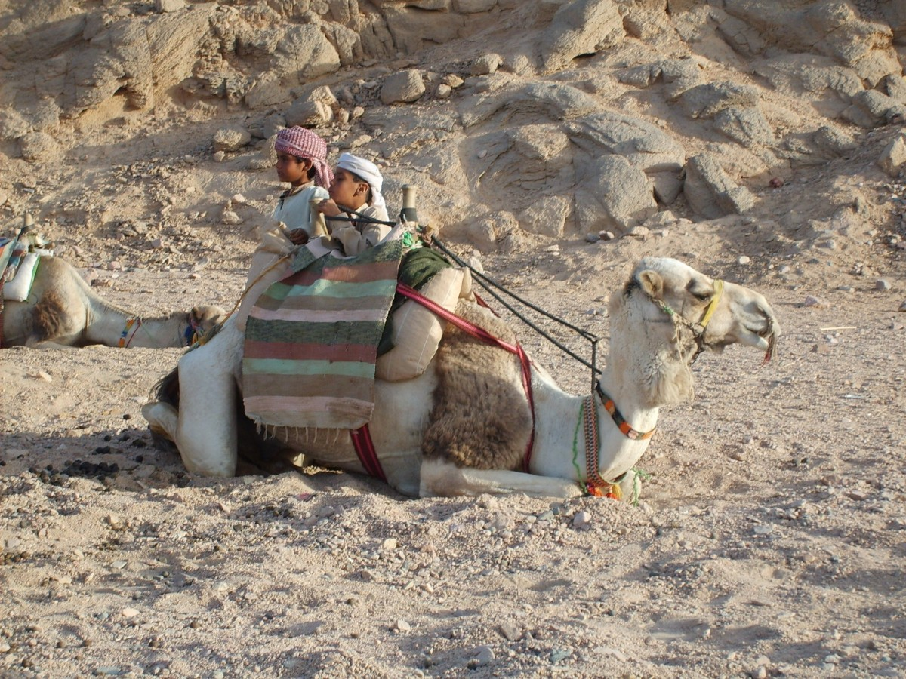
CHAPTER SEVEN
Two
Foolish Men
For a few days, they had no trouble. The camels were healthy and the weather was good – no sandstorms.
The men enjoyed the desert life, and Rashid found the way without difficulty.
But now I must tell you that Abdelhaqq had brought with him a bottle of alcohol. On the seventh day of the journey, he drank some of this alcohol as he was riding. He offered the bottle to Rashid. At first, Rashid refused to drink, but Abdelhaqq laughed at him, and soon the bottle was empty.

Slide 24
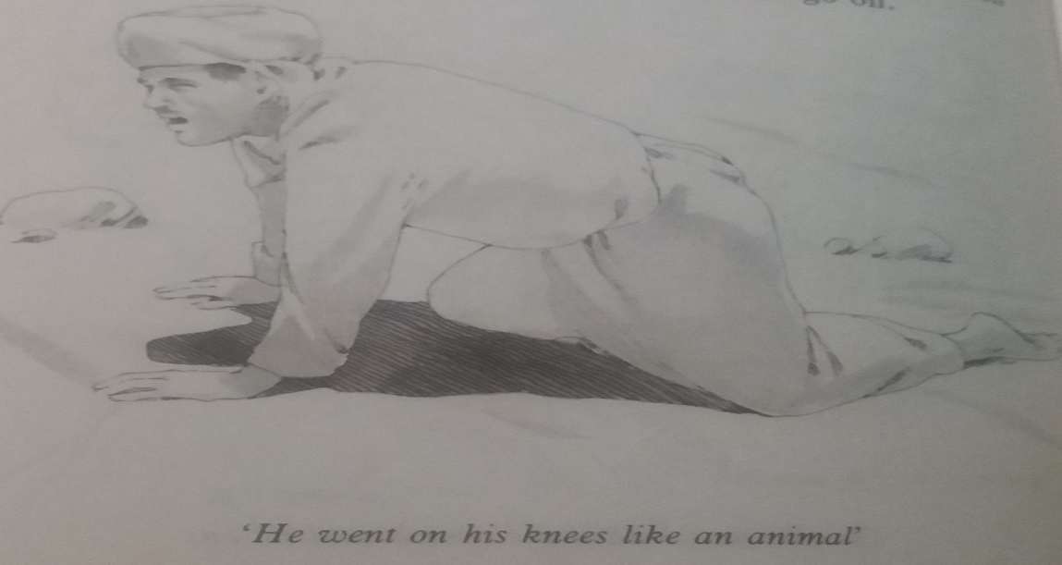
Just before sunset, both men almost fell down from their camels. They lay on the sand like dead men. The camels stood for a time, looked
at the two foolish men, and then they left.
The men woke up early the next morning and found out that the camels had gone. They quarrelled and shouted at each other. But that did not bring the camels back. So, they had
to start walking. They had neither
food nor water.
“ You can understand their difficulties,”
said Abu Khalid, looking at the fire
and at Saood and the boys.
They walked like men in a dream, until Rashid could not go on. That night, he lay down for the last time, and before morning life had left his body. So, Abdelhaqq went on alone.
He was young and strong, but his need
of water was so great.
A few hours later, he dropped to the sand and
went on his knees like an animal. Soon, he
could not stand up.
A few hours later, some Beduin, who were
going to Teewi, found him – just as we found you. They carried him with them to Teewi.
He was so close to dying that, during the
eleven days of the journey, he did not open
his eyes or speak. Not even once! He was
just like a dead man.
The Beduin took him to the home of
Omar Abdullah – the wise man of the village.

Slide 25
Omar looked after him. His house was
very close to some water in a place
where beautiful trees grew.
Each day, Omar carried Abdelhaqq
out of the house and put him down
by the water under the trees.
I think it was on the fifth day that Abdelhaqq opened his eyes for the
first time. Above him were the green
leaves of the beautiful trees, and through the leaves he could see the blue sky.
He listened. Somewhere near him a bird sang sweetly, and he could hear the most wonderful sound in the world – the sound of moving water. For a long time, he lay and listened, and then, painfully, he turned his body and looked.
He saw the beautiful clear water, and
in the water the smallest fish he
had ever seen.He watched the fish
as they played, and then he took water in his hand and drank.It was the sweetest water he had ever tasted. He drank deeply and then lay down again and rested.

Slide 26
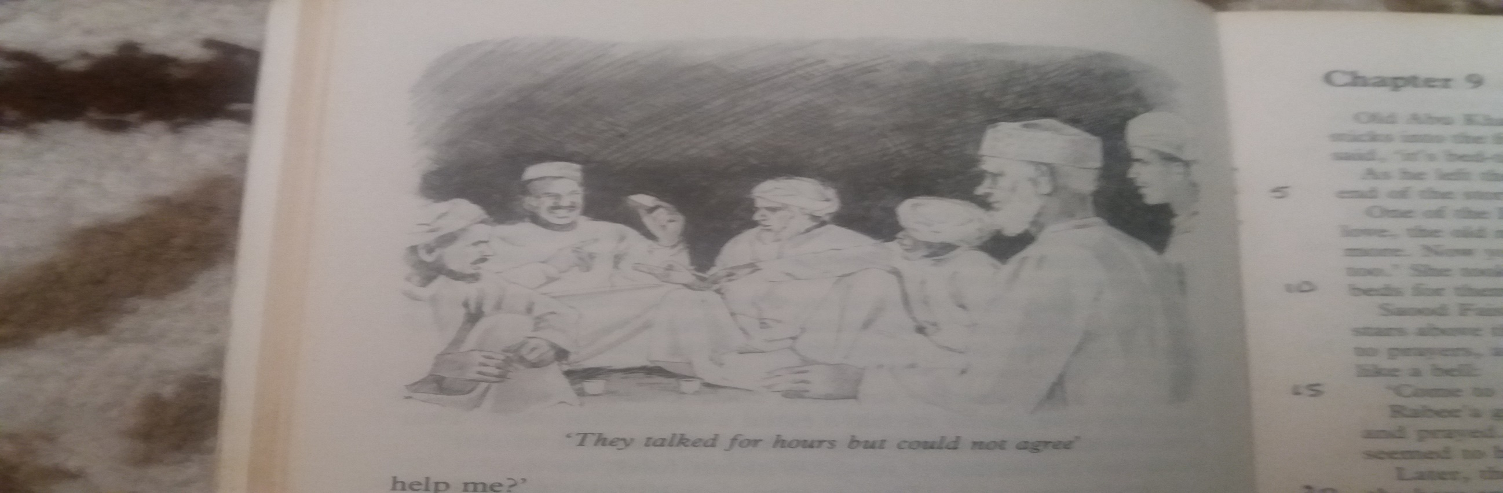
When Omar came to see Abdelhaqq later in the day, he found him sitting by the water and
still looking at it.
Omar said, “ Assalam aleikum,” and then sat down beside him. He did not speak again until Abdelhaqq looked at him. Then he said,
“ Do you feel better now?”
“ Is this Heaven?” said Abdelhaqq.
Omar smiled and said : “ If there is a heaven on Earth, perhaps this is it.”
Abdelhaqq thought.“ Then I’m not dead?” he asked. “ No, my boy, you are not dead. You are alive. Thanks Allah. You can thank the Beduin too, because they found you and brought you here.”
“ So, I am not in Heaven, and I didn’t die like
an animal,” said Abdelhaqq.
“ Why do you say that?” asked Omar.
CHAPTER EIGHT
Omar Abdullah

Slide 27
Then Abdelhaqq told Omar about searching for the right answer to the question about the most valuable thing in the world.
Omar listened quietly to the whole story and then said, “ I am Omar Abdullah, and this village is Teewi, and I think I am the man you wanted to meet.”
“ Tell me then, “ said Abdelhaqq, “ what is the right answer?”
Omar laughed and said, “ Don’t be in such a hurry, my boy. The question won’t go away. First, let’s eat. You were nearly dead. And now you live. What is more valuable than that? Come, let us go into the house.”
Together, they went into the house. Omar sent someone to bring his friends. The women cooked a wonderful meal. Prayers were said. The good food was eaten, and everybody was very happy.
After the meal, the men sat and drank cups of coffee.
Omar started, “ My friends, this evening we have among us the young man who so nearly died. His name is Abdelhaqq, and he is searching for the most valuable thing in the world. Can anyone help him?”
Omar’s friends thought deeply, and then one of them said, « Surely he has already found the most valuable thing in the world. It is his own life. He nearly lost it, and now he has it again. »
Another said, « But there is no life without water. Without water he nearly died. The Beduin gave him water, and so he lives. For all who live, water must
be the most valuable thing. »
Another man, a rather fat man, said, « Omar Abdullah, this evening in your home we have eaten a wonderful meal. The meat was tasty, I can tell you. Surely the answer to this young man’s question is food.
Without food, we die.”
A fourth man said, “ That is true. But without water we cannot grow food. So, water is more valuable than food.”

Slide 28
The men began to talk about this, but Abdelhaqq was too tired to listen. So, he left them and went to sleep
in his place.
The next morning, Abdelhaqq asked Omar Abdullah whether his friends knew the answer. Omar laughed and said, “ They talked for hours, but could not agree.”
“ Then, what is the answer?” asked Abdelhaqq.
“ You will not find the answer here, “ said Omar,
“ but maybe you have already found part of the answer. You must continue searching. You will find the complete answer in a place where you do not
think you will find it.”
“ But how shall I know that it is the right answer?”
“ You will know it in your heart, “ said Omar.
“ But I do not know where to continue searching. Can’t you help me?”
“ I think you must call on an old friend of mine,” replied Omar.
“ What’s his name? “ asked Abdelhaqq.
“ Her name is Oum Saloom”
“ A woman!”
“ Yes,” said Omar, “ a woman, and a wise one too. You will find her near Wadi Bani Khalid in Oman. Tomorrow I will give you camels and a guide. The guide will accompany you into Oman. There, at a place they call Bediya, he will leave you. From Bediya, you can go on foot to Wadi Bani Khalid. Now, you must get ready for your journey.”
Early the next day, Abdelhaqq thanked Omar for all.
“ Allah be with you,” said Omar. Then, they set out.

Slide 29
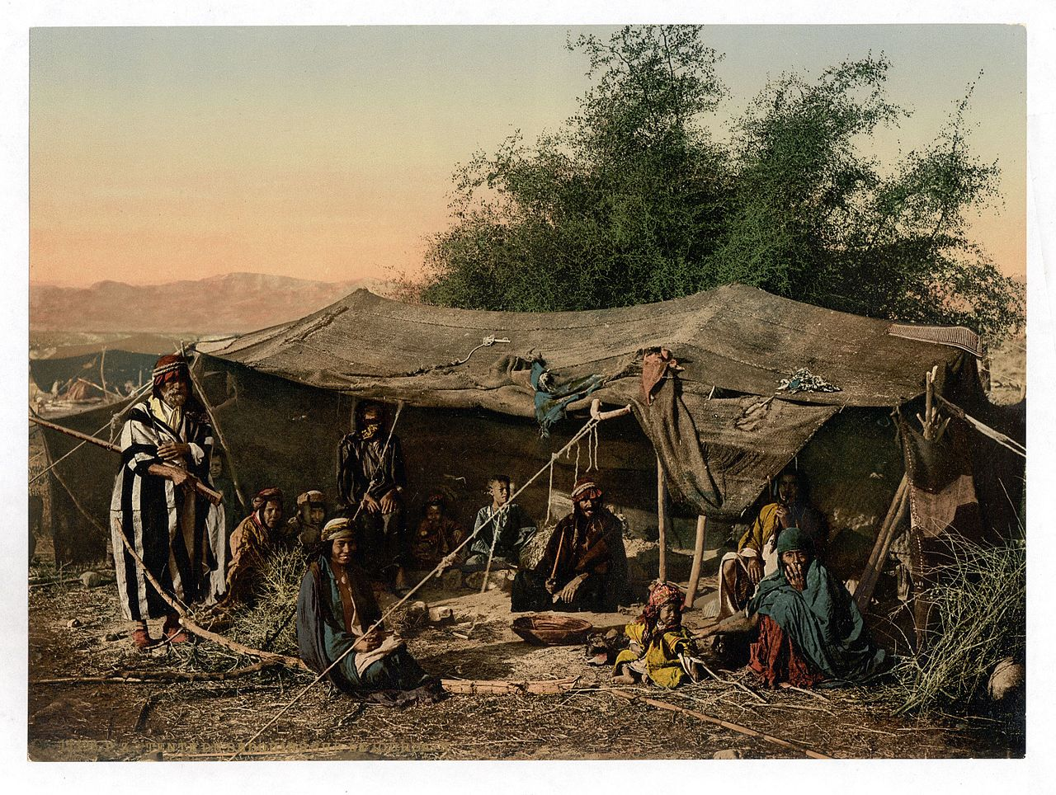
CHAPTER NINE
With The Beduin
Old Abu Khalid stopped speaking.
He threw a few small sticks into the fire and then stood up. “Allah Bless you all,”
he said, “ it is bed-time for me.”
As he left the fire-side, Sharifaasked Najaat, “ Is that the end of the story?”
One of the Beduin women heard her
and said, “ No, my love. The old man
is tired.Tomorrow night, he will tell us more.Now, you two come with me.
It is bed-time for you, too.” She took the girls into the tent and made comfortable beds for them. They were soon asleep.
Saood and the boys also slept, with the moon and stars above them.

Slide 30
When Hamad woke up, he heard the call to Prayer. , and in the clear morning air in the desert it rang like a bell, “ Come to Prayer, Allah is Great.”
Hamad got up and joined the Beduin men as they knelt and prayed. Afterwards,
the sun rose fresh and new, and it
seemed to him that the world
was born again.
Later, the Beduin brought cups of warm camel’s milk to the boys and Saood,
and then hot bread. Hamad asked them when someone would go to Shaybah.
They laughed and said that three
men had already set out.
The days passed. Hamad and his brothers had never ridden camels. So, the Beduin taught them camel-riding. It was very exciting. Hamad made everyone laugh
when he fell off.
Najaat and Sharifa enjoyed learning
how to make bread as the Beduin women make it. The Beduin girls also taught
them some dancing.
In the early evening, the boys rode camels again for a mile or two, and all of the
dogs followed them. Salim noticed that
the dogs were healthy and well looked after.
They were beautiful animals.

Slide 31
Later in the evening, there was a meal
of rice and fish. The fish was a surprise in the desert, but the Beduin had
a lot of it. They salt it and dry it
in the sun. The boys had seen it
hanging in one of the tents.
It looked like dry sticks.
Then, after the meal, little fires
were lit and coffee was made. Everybody sat comfortably on the sand again
to hear Abu Khalid continue his story.
The old man smoked his pipe for
a minute or two, and drank
a cup of coffee.
A dog moved nearer to
him and sat beside him.
Suleiman could see the
fire shining in the dog’s golden eyes.
Abu Khalid looked up
and spoke to all those
who sat listening.

Slide 32
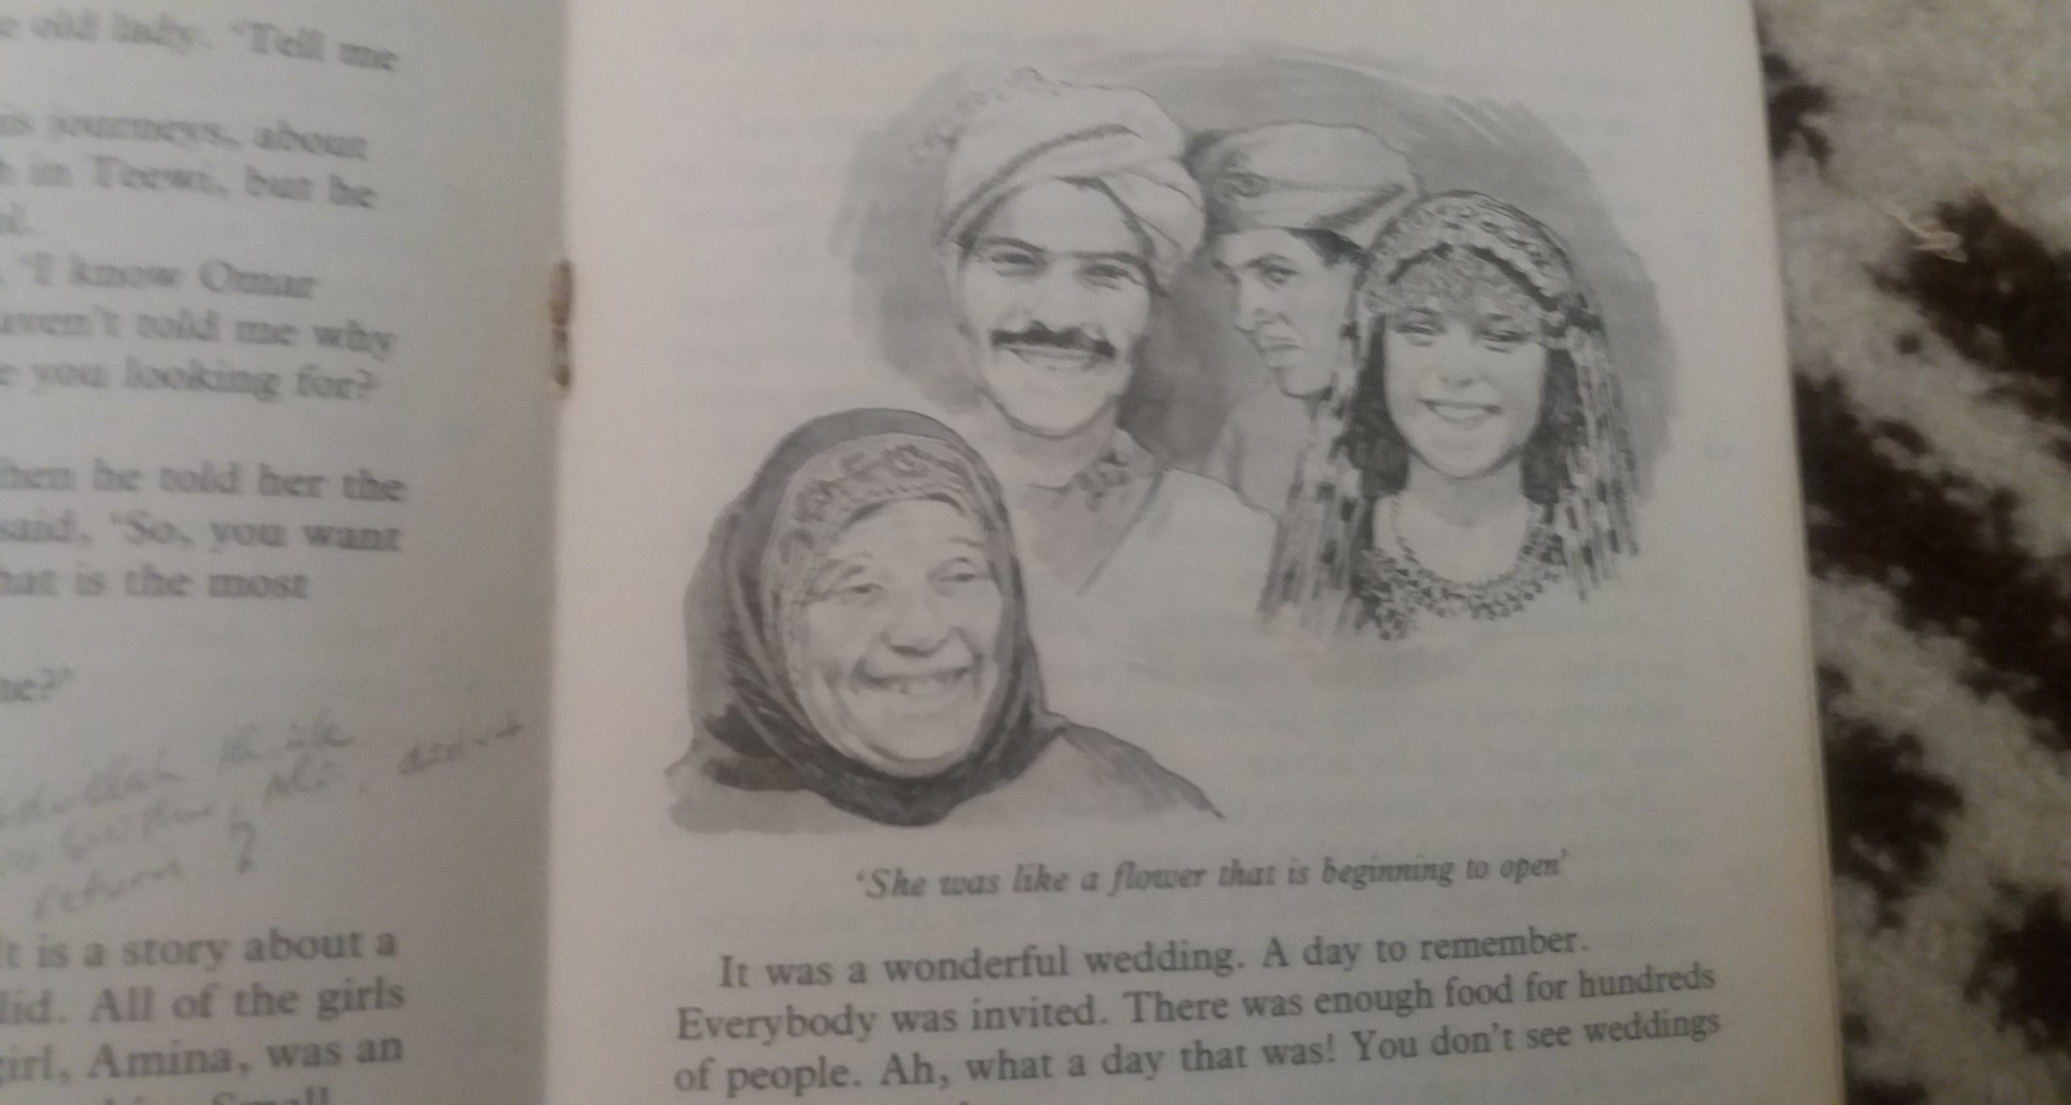
CHAPTER TEN
Oum Saloom
“ Bismillah el Rahman el Rahim,” Abu Khalid began.
“ Now, about this young fellow, Abdelhaqq. Where was
he when I stopped talking last night?”
“ He was going to Oman, to Wadi Bani Khalid,”
said a small Beduin boy.
“ Ah, yes. Now, I remember,” said Abu Khalid.
Abu Khalid’s story (2)
Well, his journey was easy. He had a good guide to show him the way and look after him. Omar Abdullah’s camels were strong and fast. There was water in the wells, and the guide knew where all the wells were. So, they had no trouble and came safely to Bediya in Oman.
Abdelhaqq said goodbye to his guide, and the man took the camels back to Omar Abdullah. Then, after resting for a day or two, Abdelhaqq set out on foot for Wadi Bani Khalid.
He soon found that he had to climb over big rocks, but the people he met were friendly. When he asked about Oum Saloom, they said he was on the right path. On the second day, he came to the wadi and followed it for some hours,
and at last he came to something which surprised him.

Slide 33
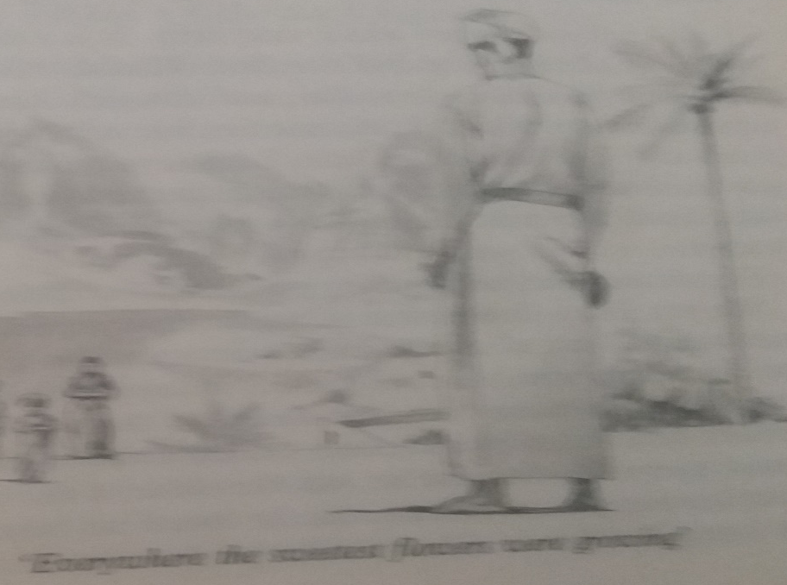
It was a large lake of clear water, and all round it
beautiful flowers were growing. Since he left Teewi.
He had not seen such water. Beautiful clear water,
as blue as the sky. He certainly drank well that day.
He even took off his clothes and walked into the water.
He had never seen so much beautiful sweet water.
It was just like heaven.
Well, he followed the wadi higher and higher, and everywhere the sweetest flowers were growing. He came to a small village, where someone gave him dates and fruit, and brought him coffee to drink. And when he asked again
about Oum Saloom, someone took him to her house,
and the people of the house invited him to go in and sit down. He sat and waited until the old lady came into the room with her young grandson. The boy brought her a seat, and when she was comfortable, she spoke to Abdelhaqq.
“ Do you want to see me?” the old lady asked.
“ If you are Oum Saloom,” said Abdelhaqq,
“ yes, I do want to see you.”
“ They call me by that name,” said the old lady.
“ Tell me about yourself.”
Abdelhaqq told her about all his journeys, about
nearly dying, and about Omar Abdullah in Teewi.
But, he didn’t tell her about the bottle of alcohol.
The old lady listened. “ Yes,” she said.
“ I know Omar Abdullah. He is a good man.
But you haven’t told me why you are making
these journeys. What are you looking for?
Have you no home?”

Slide 34
Abdelhaqq was quiet for a moment, and then he told her the whole story. When he had finished, she said, “ So, you want to know the answer to the question- what is the most valuable thing in the world?”
“ Yes,” said Abdelhaqq. “ Can you help me?”
“ I shall try,” said Oum Saloom.
Oum Saloom’s story
I shall tell you a story which may help. It is a story about a young girl, Amina, a girl of the Beni Khalid. All the girls there are beautiful. But Amina was an unusual beauty.
Not too tall, not fat, not thin. Small hands and feet, long black hair. Large eyes, like those of a gazelle. Small, straight nose. Beautiful mouth and neck. Soft skin. Teeth like milk. Voice like a song-bird’s. Oh! She was a beauty.
The old lady stopped speaking and seemed to dream.
She was like a flower that was beginning to open. All of
the men wanted her, of course. But there were two brothers, Ali and Abdullah, who were very much in love with her.
They both wanted to marry her, and she liked them both. Their families were friendly, and their fathers decided that she would marry Ali, because he was the elder of the two. Abdullah was sad of course, but he loved his brother and was happy for him.
It was a wonderful wedding. A day to remember. Everybody was invited. There was enough food for hundreds of people. Ah! What a day that was! You don’t see weddings like that nowadays.
And then, not long after the wedding, Ali had to leave
Wadi Bani Khalid and go to do some business in Laamu in East Africa. He hoped to return after three or four months.

Slide 35
Amina was sad. But she waited lovingly for her husband. He was a good fellow and she really loved him.
Well, the weeks passed, and became months. The months passed, and became years. People in the village here
began to think that Ali would never return, that he was even dead, perhaps. Abdullah, the younger brother, began
to think that if Ali did not return, perhaps Amina would take a new husband. He began to dream about marrying her. He began to burn with love for her. He couldn’t eat,
and he could’t sleep. He became quite ill with love, poor boy. One day, he decided to tell her about his love.
She listened to him at first and then became angry and said, “My brother, Abdullah, I call you my brother because you are my husband’s brother, and he and I are one. Because you are my brother, you can never be my husband. My husband is Ali, and I will love him always. While day follows night and night follows day, I will love him and be his good wife. While the stars shine at night and the sun moves across the sky each day, I will love only him.
Him and only him.”
“ But perhaps he is dead,” said Abdullah
“ Yes,” said Amina, “ perhaps he is dead, but I think that,
if he were dead, I would know it in my heart.”
Abdullah tried to make her forget about his brother, but failed. She would not listen. He went away, still burning with love, and his illness became worse. He decided to
visit a wise man and ask for advice.
The wise man listened to him and asked: “ What did the girl say when you told her that you love her?”
Abdullah replied : “ She said that she will love Ali while
the sun moves across the sky each day and the stars
shine at night. Always, always,”
The wise man thought for some time…
” While the sun moves across the sky each day?”
“ Yes,” said Abdullah.
“ Mmm,” said the wise man, “ I think I can help you.”
He went to some large books in his room and began reading, and then he said, “ On the first Friday of next month,
the sun will disappear from the sky at midday.”
“ Will it be the end of the world?” asked Abdulhaqq.

Slide 36
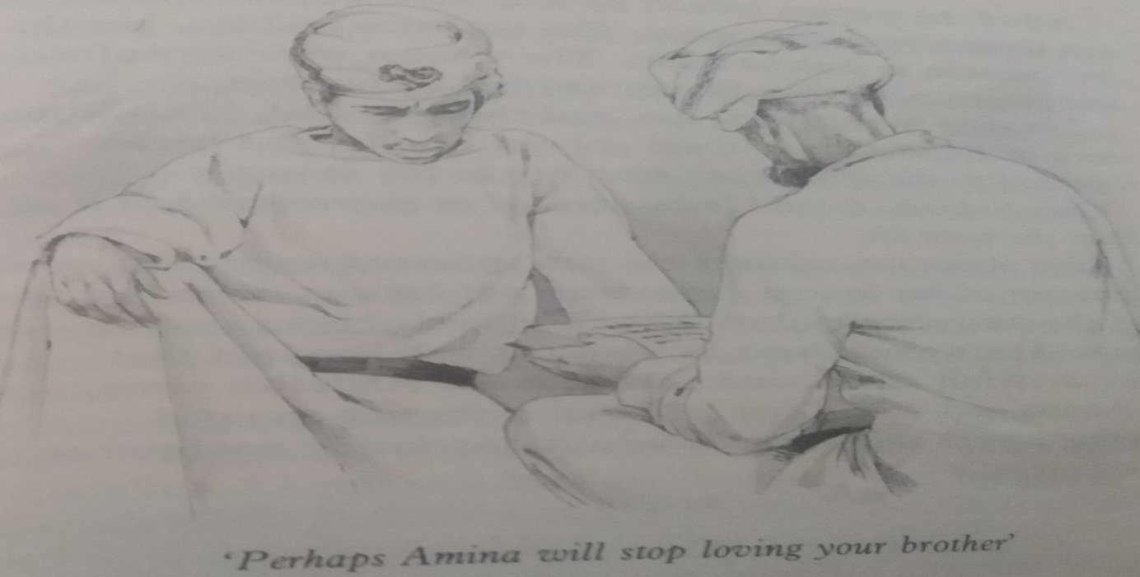
“ Oh no,” replied the wise man, “ the sun will disappear from the sky for about tem minutes and then it will come back again. It won’t be the end of the world, but perhaps Amina will stop loving her husband. That is all I can
tell you. Now, go and think about that.”
Abdullah went away and started thinking about that.
“ So, if the sun stops moving across the sky one day,
you will stop loving him?”
Amina laughed and said, “ If the sun stops moving across the sky, it will be the end of the world, the end of everything. So, yes, perhaps I will stop loving my husband, because everything will stop.”
“ Good,” said Abdullah, “ Remember what you have said.” And he went away.
Amina was sorry for him. She thought that his
illness was making him mad..
Three Fridays later, she was fetching water and talking to some of her friends near the well. Suddenly, one of
them shouted, “ Look at the sun !”
All of the women looked up and were surprised to see the sun beginning to disappear. The time was midday, but the day became as dark as night. The women were very afraid,
and some ran to their homes and hid themselves.
The men were afraid, too.. They shouted, “ This is the work
of Iblis !” One of them got out his gun and began
shooting in the sky. Some men ran to the Mosque.
Then, he went to Amina and said, “Did you say that
you will love my brother while the sun moves across
the sky each day?” “yes,” said Amina, “ I did say that.”

Slide 37
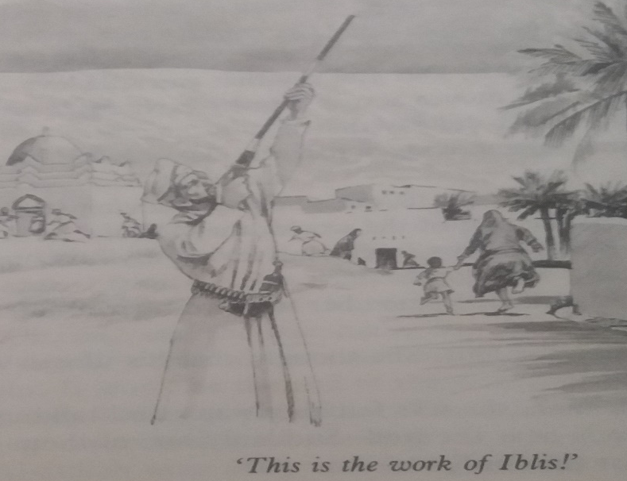
Oum Saloom, the old lady, laughed as she remembered it all.
Then she went on.
“ Amina,” said Abdullah, “ stop thinking about Ali.
He will never come back. You know that I love you very much. Forget about Ali. Let’s go to your father and
ask him to get you a divorce from Ali. Then,
we can get married. I love you, Amina.”
Amina listened. She began to think about it… “ yes..
Perhaps he is right. Perhaps Ali will never come back to me.” But then she said, “ Abdullah, I know you love me, but let’s wait longer. If Ali does not return before the end of another year, we will go to my father together and ask him.
” She began crying again.
Abdullah began to be very sorry for her. “ Amina,” he said,
“ please forgive me. I am really sorry. I knew the sun was going to disappear and I tried to trick you. Perhaps Ali
will return to us. I hope so. You are a real good wife to him. I shall go on loving you always, but I shall love you
as my sister, not as my wife.”
When she heard this, she was happy and she said,
“ I forgive you, my brother.”
After about ten minutes, the sun appeared again, and we all came out of our houses. That man put his gun down and said that he was not
afraid of Iblis. The birds began singing again. The women
went back to the well and said that they were
not afraid at all.
Later that day, Abdullah came to Amina and said,
“ You said that if the sun stops moving across the sky,
you will stop loving my brother, didn’t you?”
She was a very honest girl. She said , “ Yes, I did say tat.”
“ Well, then,” said Abdullah, “ The sun did stop, didn’t it?
You must stop loving my brother and think about marrying me.”
Amina began to cry. She needed her husband, Ali.
She loved him. Why had he not returned?
He must be dead, surely.

Slide 38
“ Well,” said Oum Saloom to Abdelhaqq, “ what do you
think happened next?”
“ Did Ali come back?” asked Abdelhaqq.
“ He did.,” she replied.
Three months later, Ali returned. He had had a long
illness in Laamu, but at last he was better, and had returned as soon as possible. All the people in the
village were glad to see him again.
Amina was the happiest girl in the world. Even Abdullah was happy, because he really loved Ali. In fact,
Abdullah killed five sheep and everyone in
the village came to eat at his house.
There, Ali spoke to them and said: “ Today is the
happiest day of my life because I have returned
safely to my loving wife and my brother.”
Abdullah also spoke and said, “ Today is the happiest
day of my life, too. My brother has returned to us
and today I understand what real love is. It is
worth more than the largest diamond.”
Just then, Oum Saloom stopped speaking.
She looked at Abdelhaqq and said, “ The love of a
woman for her husband is the most valuable
thing in the world.”
Then, she stood up , with her grandson ’s help.
As she was leaving the room, she said to Abdelhaqq,
“ Allah guide you.”
Abdelhaqq left the house, deep in thought.
He continued climbing over the rocks and up
the mountain till he came to the top.. There, he lay down and slept under a starry sky.
“ And now,” said old Abu Khalid, “ I think it’s time
for us to go to sleep too. Allah Bless you all.”
He stood up and walked away from the fire.
After a few minutes, Najaat and Sharifa, Saood
and the boys, and most of the Beduin went
to their beds and were soon asleep.

Slide 39

The next morning, Hamad woke up very early. He lay
still and looked up at the stars, and thought about Abu Khalid’s story, and about Abdelhaqq
and his search
for the most valuable thing in the world.
Hamad thought about his mother and father
in Muscat, and their love
for him and his brothers and sisters. He wondered
whether the Beduin who had gone to Shaybah
would bring help. He wondered
whether the helicopter
would come. He wondered when he would
see his parents again. He wondered about
the Beduin and about
the hard life they live in the desert.
“ It’s a hard life !,” he thought, “ but they seem
to be happy with it. What is the secret of such happiness?”He wondered about all these
questions and many others.
CHAPTER ELEVEN
What Is The Most Valuable Thing In The World

Slide 40
Then once again, the call to Prayer rang out, and
the Beduin went to kneel and pray. He went and
joined the line of men.
Later that day, Hamad and his brothers and sisters talked about Abu Khalid’s story. Saood Faysal, the pilot, joined them. They talked about the question which Abdelhaqq must answer when he went back to his village.
“ Health,” said Saood. “ Health is the most valuable thing. Without health – nothing. Look after your health. No cigarettes. No alcohol. A lot of exercise. That is the secret. There is nothing more
beautiful than health.”
“ I think that learning is the most valuable thing,” said Salim. “ You can learn a lot by reading books.”.
“ What do you think, Hamad?” said Suleiman.
“ Health is very important,” replied Hamad. “ And so is learning. They are both very valuable, I think.”
In the tent, Najaat was also talking about Abu Khalid’s story. She was talking to one of the Beduin young women, while this young woman was
painting her hands
and feet with Henna.
“ What do you think is the most valuable thing
in the world?” asked Najaat.
“ Love,” answered the young woman. It is love my dear,
but you are too young to understand. You will do when
you get older.. Here, let me put more Henna on
your hands.”
In this way, the third day in the desert passed, and in
the evening, Abu Khalid came again to the fire-side,
made himself comfortable, and continued his nice story.

Slide 41
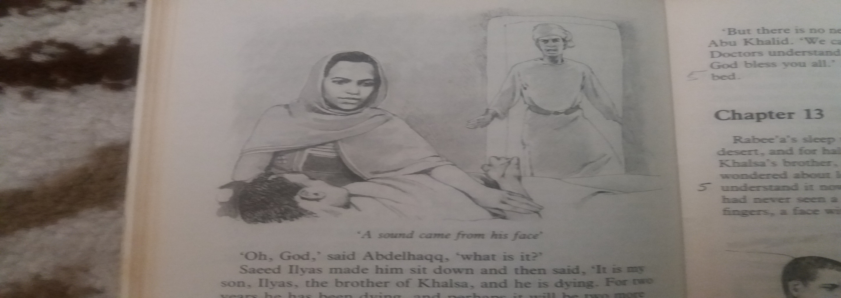
Abu Khalid’s story (3)
“ Bismillah,” said Abu Khalid.
This evening, I am going to take you all to Africa because Abdelhaqq went there next. He climbed down the mountain near the Wadi Bani Khalid, and came to the sea, and there, near a place called Qalhat, he saw a ship.
The Captain of the ship was getting it ready to go to sea. When he saw Abdelhaqq coming, he spoke to him.
“ You are a strong young fellow,” he said .
“ Where are you going?”
“ Nowhere,” replied Abdelhaqq
“ Nowhere!”, said the Captain, and he laughed.
“ That’s a funny answer. You must be going somewhere.”
“ No,” said Abdelhaqq. “ I am not going anywhere.
I’m just going from place to place. I am trying
to discover something.”
The Captain laughed again. “ Yes,” he said. “ And I think I know what it is –something valuable, eh?
Gold, is it? Silver, perhaps?”
“ I am not sure what it is, or where I can find it,”
said Abdelhaqq.
CHAPTER twelve
Khalsa

Slide 42
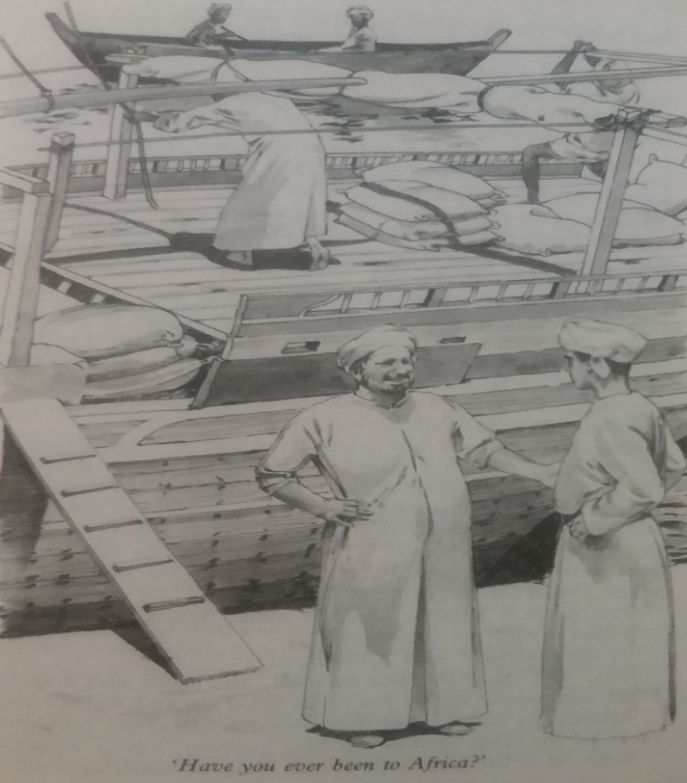
“ Aha,” said the Captain. “ A secret, is it? Now, you listen
to me, my lad. I need a strong young fellow like you on my ship. We’re setting out today for Africa.
Have you ever been to Africa?”
“ No,” answered Abdelhaqq.
“ Then, you can come with us, Perhaps you’ll find
the thing that you are looking for. Africa is full of secrets. There is always something new there.. Will you come?”
“ Why not!” thought Abdelhaqq.
When he had done his work, Abdelhaqq liked to sit and watch the flying-fish jumping out of the water and flying across the sea. Most of the time the ship followed the coast.
At night, the Captain used the stars to help him to find the way. They passed Aden and then Jibuti. They stopped at Berbera and Mogadishu for fresh water. The Captain had decided to go to Pemba. It is an island near Zanzibar. He wanted to sell dates there and to buy some gloves. So, he brought his ship into port at Wete in Pemba.
The dates were taken to the market and sold. Then,
the Captain decided to paint the ship with oil before setting bout again. The men of Wete are clever at painting ships
and getting them ready for sea again. Abdelhaqq knew nothing about that.. So, he walked from place to place, and sometimes he stopped to drink juice from young coconuts.
It was sweet and always cool.
One day, as he sat to drink from one of these coconuts,
he noticed a young girl going to fetch water. She had the most beautiful eyes he had ever seen , but the eyes look sad, very sad. He wondered why she was so sad.
“ Who knows what I may find there?”
He agreed to go.
A few hours later,
the ship set out and Abdelhaqq began
learning to be a sailor.
There was a strong wind blowing from north to south at that time of the year, so the ship went
like a bird.

Slide 43
On the third day, he waited to see her. When she
came by, he saw that her eyes were still the same –
very beautiful but very sad. He asked a man for
the name of this girl..
“ Her name is Khalsa,” replied the man.” She is beautiful, but you take my advice – forget about her.”
“ Is she married?” asked Abdelhaqq.
“ No,” said the man, “ not married, and there is not a
man in Wete who would marry her.” He stood up and walked away. Abdelhaqq asked others about this Khalsa, but he always received the same answer –
“not married, but – forget her.”
Soon, as is the way with young men, Abdelhaqq could
think of nothing except this girl, Khalsa. He thought all
the time about her beautiful eyes, and he wanted to see
them happy and smiling. Very soon, he got in love with her. And decided to go to see her father and ask for her to become his wife. Someone told him where the house was. The next afternoon, he went there and asked to see the father of Khalsa. He was invited into the house
and given “halwa” and coffee.
The father then came and asked Abdelhaqq
what he wanted.
Abdelhaqq said, “ I am in love with your daughter
and I want to marry her.”
The father, Saeed Ilyas, said, “ In love ! How can you
be in love with a girl you hardly know?”
“ I have seen her several times,” said Abdelhaqq,
“ and I know in my heart that I love her.”
Ilyas looked at him and said, “ Love, is it? What an easy word to say ! Most people don’t know the meaning of it. Shall I show what love is? Come with me, young man,
and I’ll show you the meaning of love. And then if you want to marry my daughter, I shall not stop you.”
Saeed Ilyas led the way, and Abdelhaqq followed.
They went to a room at the back of the house.
The father opened the door and asked Abdelhaqq to enter. He went in and then stopped suddenly. There was a bed
in the room, and a man was lying on it. The girl,
Khalsa, was sitting by his side, and she was holding
the man’s hand in one of hers.

Slide 44
Abdelhaqq looked at the hands. The girl’s hand was as beautiful as her eyes, but the man’s hand was ugly – it had no fingers. He looked at the man’s face, and began to feel ill – the face was like a lion’s, and the nose had sunk into it, leaving just a hole. He looked at the feet –they had no toes. There was a bad smell in the room. The man on the bed moved and a sound came from his face.
Abdelhaqq felt sick. He ran out of the room and into the fresh air. The father followed him and held him by the arm.
“ Oh, Allah,” said Abdelhaqq, “ what is it?”
Saeed Ilyas made him sit down and then said ,
” It is my son, Ilyas, the brother of my daughter, Khalsa, and he is dying. For two years he has been dying, and perhaps it will be two more years before he dies.
Khalsa has been looking after him since his illness began, and I know she will look after him until the day of his death. That is the meaning of love, young man.”
“ But what is it ?” asked Abdelhaqq. “ What is it?”
“ It is an illness called “ Leprosy”.”
“ Leprosy !” shouted Abdelhaqq. “ Ya Allah !. Let me go!”
He jumped to his feet and ran out of the house.
Ke kept running until he got to the ship. There,
he washed himself with sea-water.
That night, his sleep was troubled by
nightmares – bad dreams.
“ But there is no need for our sleep to be troubled,” said old Abu Khalid. “ We can sleep well and dream good dreams. Doctors understand leprosy now.
Goodnight, everybody, and Allah Bless you all.”
He left the fire-side and went to bed.

Slide 45
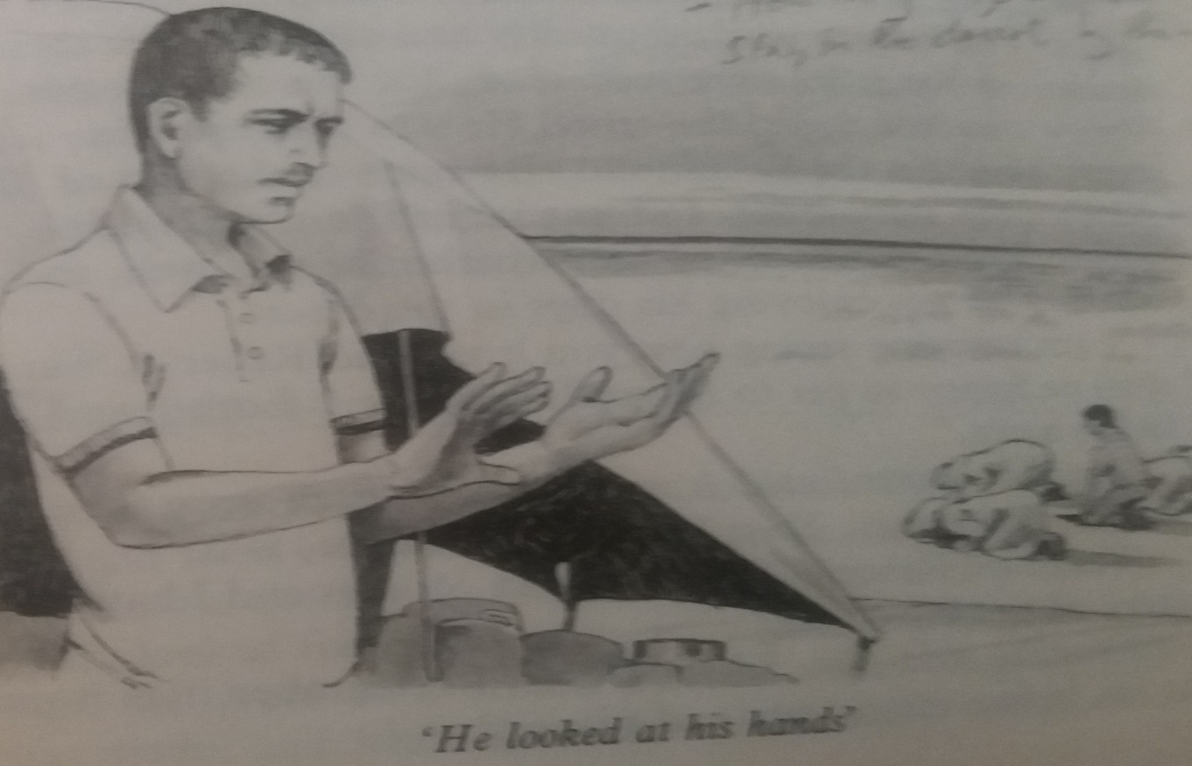
CHAPTER THIRTEEN
Hamad sleep was troubled. It was the third night in the desert, and for half of the night he lay awake, thinking about Khalsa’s brother, the leper, and about Abdelhaqq. Hamad wondered about leprosy. Abu Khalid said that doctors understand it now, and Hamad thanked Allah for that. He had never seen a leper, but he thought about hands without fingers, a face without a nose, and feet with no toes. When he slept, he dreamt about lepers.
Hamad

Slide 46
He woke up early and heard again the call to Prayer.
It rose into the desert air, as it had risen everyday since Bilal first called men to Prayer in the era of Prophet Muhammed Peace Be Upon Him. Hamad got up. He looked at his hands and feet. He felt his face.
Everything was all right !
He went to join the Beduin in Prayer. As he knelt, he noticed that his brother , Suleiman, was also kneeling
in the line of men.
After Prayer, the Beduin brought dates and bread to eat, and camel’s milk to drink. “ Bismillah, “ they said, as they said so often. “ Everything is from Allah,” they added.
The day passed slowly. Saood Faysal often looked at the sky to see whether a helicopter was coming. He had tried the radio again and again. With help from the Beduin and the boys, he had tried to move his plane out of the soft sand, but the plane was stuck and it was just impossible to move it.
Najaat and Sharifa helped the Beduin girls to clean rice. The Beduin women were happy and excited because they were going to cook a big meal. “ This may be your last day with us,” they said, “ so, this evening you must eat well.”
Suleiman and Salim watched the Beduin men kill
two goats. They worked quickly and cleverly with their knives, so the goats were soon ready for the cooking-pot.
Hamad walked round the tents. He was interested in everything the Beduin did.
He came to the tent of Abu Khalid, the story-teller, and was invited to sit and drink coffee.
The old man asked him whether he was well,
and if he was enjoying his stay in the desert.
“ I am enjoying seeing how you live,” said Hamad,
“ but I shall be happy to get to Muscat
and see my parents again.”
“ A good answer,” said Abu Khalid. “ A man must love his mother and father. Your home is in Muscat, is it ?”
“ Yes,” said Hamad. “ I was born in Muscat and
I have lived there all my life so far.”
“ Muscat,” said Abu Khalid. “ Yes, I remember it as
it used to be, before motor-cars and planes.”

Slide 47
“ Was it a better place then?” asked Hamad.
The old man thought about this question carefully.
He lit his pipe and smoked a little tobacco. Then, “ In some ways, I think it was better. People had less food. Water had to be carried. There was more illness. There were no schools. It was a hard life for almost everybody. Not as hard as life in the desert, of course, but, yes, a hard life. And yet,
I think that people were happier then. They had more time for each other. Now, they have almost everything, it seems, but very little time for each other. But this is true of all cities, not just Muscat. And, of course, I am old, and old people do not like change. “ Also, I am a Beduin, and we Beduin do not like the cities.”
“ I think that your life in the desert is hard,” said Hamad.
“ Hard? Yes,, but we are born to it, so it does not seem
to us as hard as it seems to you. You were born to city life and you know how to live it. If I go into a city,
I may get knocked down by a car.”
“ If you come into the desert ----------.”
“ I fall off a camel ! “ said Hamad.
“ Indeed,” said Abu Khalid. They both laughed.
“ So, we are different,” said Hamad.
“ We have some differences,” said Abu Khalid, “ but we are not very different. We are both Arabs, Hamad, and whether we live in a city
or a desert, we are both Muslims.”
Abu Khalid and Hamad talked together
for quite a long time, and so the day passed
until the evening Prayer.

Slide 48
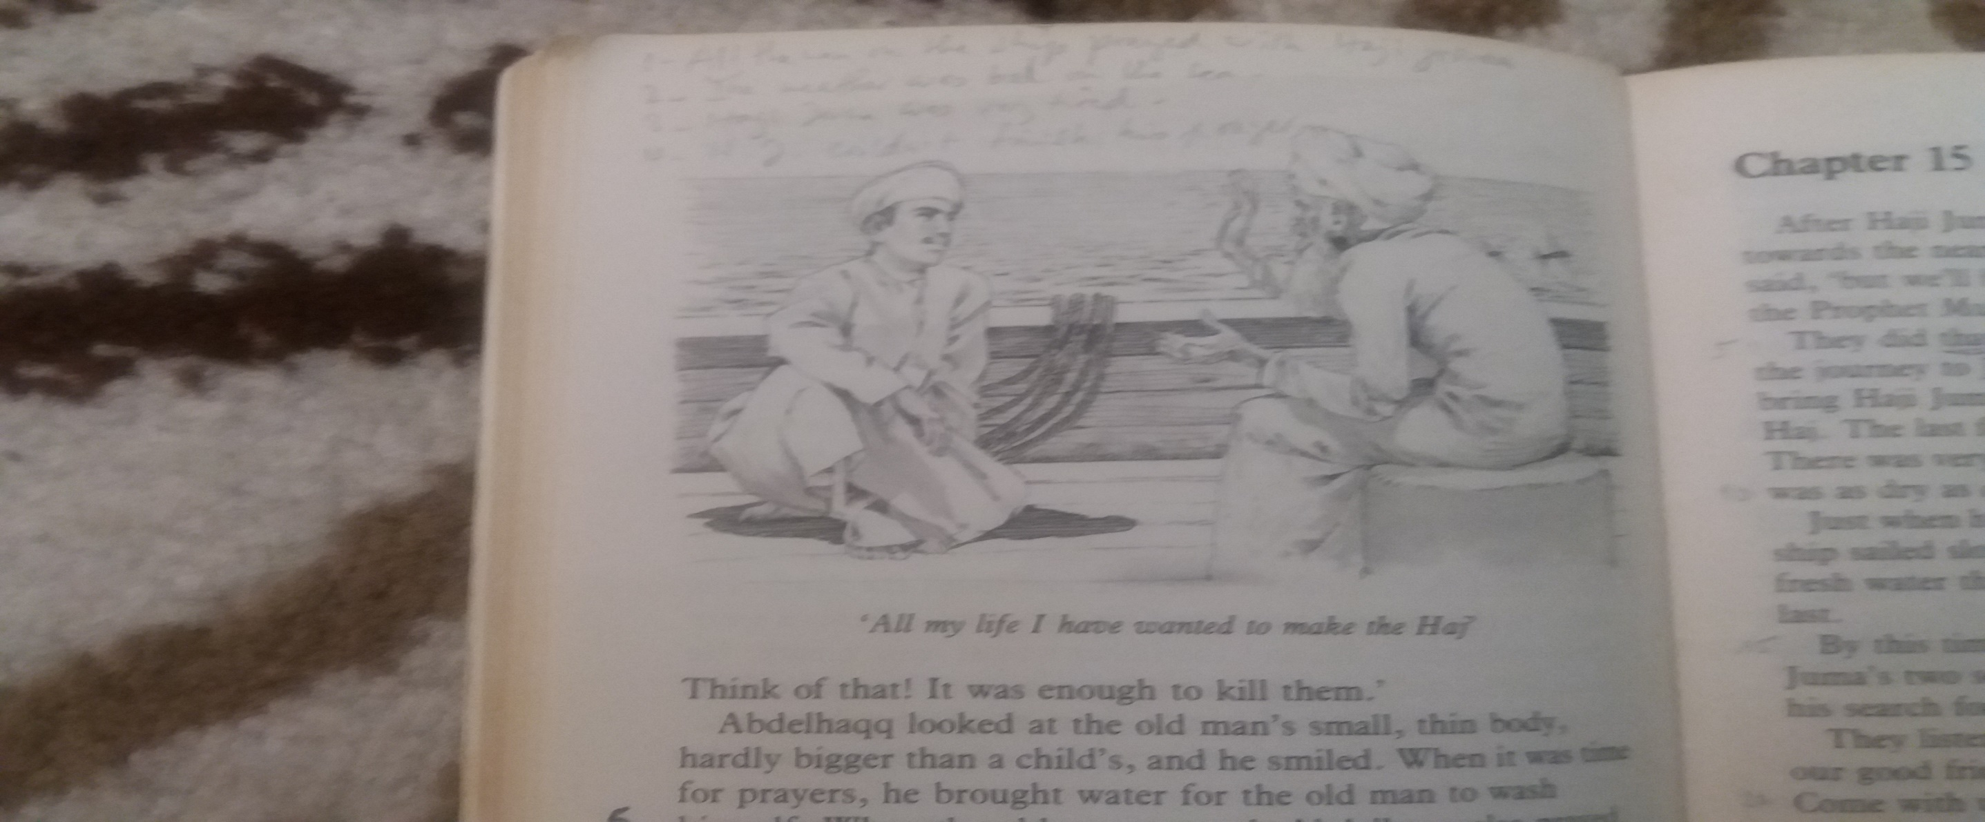
After Prayer, there was a wonderful smell of cooking
in the air, and soon everybody sat down to eat rice
and meat. The Beduin ate quickly, but the man who was sitting next to Salim looked for pieces of meat
in the rice and gave them to him. Salim ate till he
could eat no more. Then, the coffee was made, and
while the men were drinking coffee, old Abu Khalid
took his place by the fire-side. He threw a few sticks
into the fire and then began.
Abu Khalid’s story (4)
Bismillah El Rahman El Rahim ! The young man Abdelhaqq, when he ran away from the leper,
had only one idea – to live Pemba as quickly as possible. As soon as the ship was ready to leave, he helped to carry bags of cloves and fill the fresh-water pots. He worked hard. In fact,
the Captain had never seen anybody work so hard. They left Wete with a good wind behind them
and travelled north.
CHAPTER FOURTEEN
Haji Juma

Slide 49
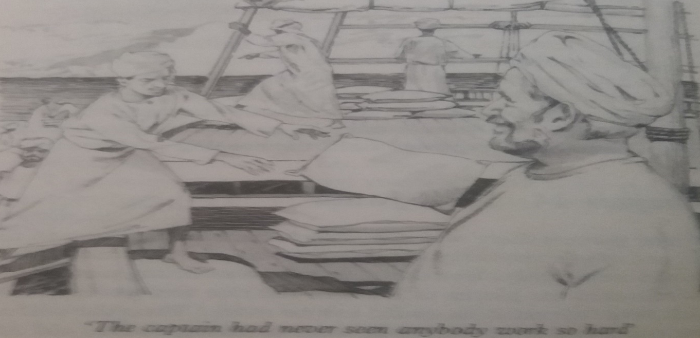
Now, at that time of the year, the month of
the Haj was near, and people were travelling towards Mecca from all over the Muslim world.
It was before the days of motor-cars and planes,
so the journey to Mecca from some parts of the Muslim world took a long time – perhaps a year,
or even longer! People walked, or went on camels,
or went by sea, but the ships had no engines.
At Ras Thany, three pilgrims for the Haj
climbed into the ship. Well, I say “ climbed into it”, but, in fact, only two of them climbed, and
the men had to lift the third. The tree pilgrims were a father and his two sons. The sons were about sixty years old. The father was at least ninety. He could hardly walk. His sons brought
him to the coast from their village. It had been
a journey of forty days, and they had used
camels and donkeys. Sometimes they had even carried him themselves.
The sailors showed the three pilgrims where they could put their things. The ship left at once.
The sailors were surprised to see Abdelhaqq
washing himself several times each day,
and they saw him looking at his fingers
and toes like a child
who is learning to count.
For many days, Abdelhaqq did not even ask where the ship was going next. He just wanted
to get away from Pemba, and he wanted
the ship to sail faster and faster. So, he was surprised one day when he saw the land ahead. The ship went into a very small port.
The sailors told him it was Ras Thany.

Slide 50
The old father’s name was Juma, and the sailors called him Haji Juma, or sometimes “ Mzee Juma”.
When they called him “ Haji”, his eyes brightened and he smiled happily. He loved to hear his sons reading from the Holy Koran. Sometimes,
he took his “Ihram” from his bag and held it against his face lovingly. He was a nice old man, and Abdelhaqq used to sit by him while they watched the flying-fish and talked. Haji Juma
told Abdelhaqq all about his forty-day journey
to the coast, and also about his two sons.
He loved them very much.
“ Fine lads, they are,” he said, “ fine lads.
All my life I have wanted to make the Haj, and now I am making it – with their help. Alhamdulillah! They even carried me, you know. Think of that! It was enough to kill them.”
Abdelhaqq looked at the old man’s small, thin body, hardly bigger than a child’s, and he smiled.
When it was time for prayer, he brought
water for the old man to wash.
When the old man prayed. Abdelhaqq also prayed.
The journey was long and hard, and the heat in the Red Sea was great. There was no rain. Soon, the fresh-water pots were almost empty. All the sailors felt ill. Haji Juma lay like a sick child, while his sons wetted his mouth with a little water, and read the Koran to him. The Captain tried hard to sail faster. The old man was nearing death. He would never see Mecca. His sons dressed him in his Ihram. “ Allahouakbar, he said, “ Lebeyk, Lebeyk!”
He died in his sons’ arms.

Slide 51
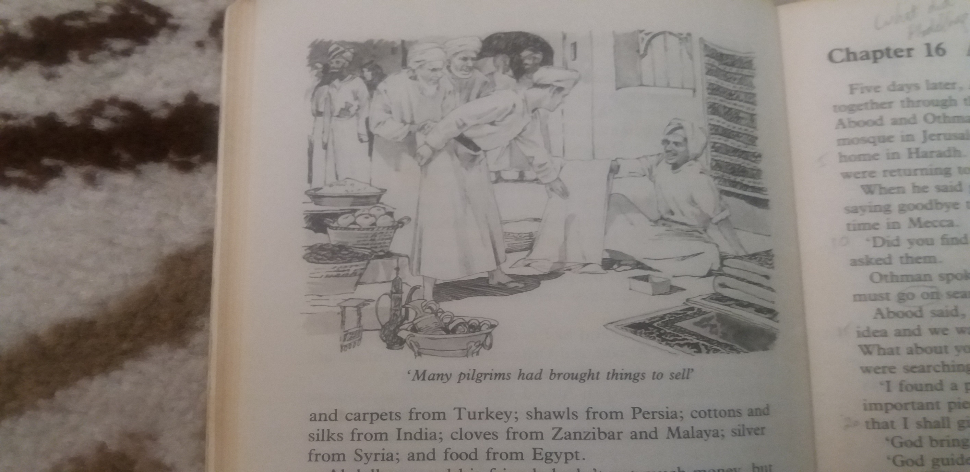
CHAPTER FIFTEEN
After Haji Juma died, the Captain at once
turned the ship towards the nearest coast.
“ We won’t find water there,” he said, “ but we’ll bury the old man properly in the land where
the Prophet Muhammed lived.”
They did that and then left quickly and continued the journey to Jiddah. The Captain promised to try to bring Haji Juma’s two sons to Jiddah by the first day of Dul Hijja. The last few days of the sea-journey were very hard. There was very little water to drink. Abdelhaqq’s mouth was as dry as chalk. His tongue was stuck to his teeth.
Just when he thought that he would die without water, the ship sailed slowly into the port of Jiddah. The sailors got fresh water there, and they were all able to drink freely at last.
By this time, Abdelhaqq had become friends with Hajji Juma’s two sons. Abood and Othman.
He told them about his search for the most valuable thing in the world.
The Pilgrims

Slide 52
They listened, and then Abood said, “ Abdelhaqq, you are our good friend. You helped our father.
Let us help you. Come with us to Mecca. We, too, are searching for something, and we hope that
we shall find it in Mecca. Let us make the Haj together. What do you say? Will you join us? Take our father’s place and come with us.”
Abdelhaqq thought about this idea, and decided
to go with them on pilgrimage. They thanked the Captain of the ship for everything he had done to help them. They gave him some money. Then the three of them left the ship and went into Jiddah.
What things they saw in Jiddah ! Pilgrims had
come from Morocco, Lybia, Egypt, Turkey, Syria, India, Persia, Malaya, East Africa, Sudan, West Africa, and even Russia ! The Syrians had arrived with fifteen thousand camels !
I tell you, there was great work for
the Beduin in those days.
Many pilgrims had brought things to sell.
There were shoes and carpets from Turkey, shawls from Persia, cotton and silk from India, cloves from Zanzibar and Malaya, silver
from Syria, and food from Egypt.

Slide 53
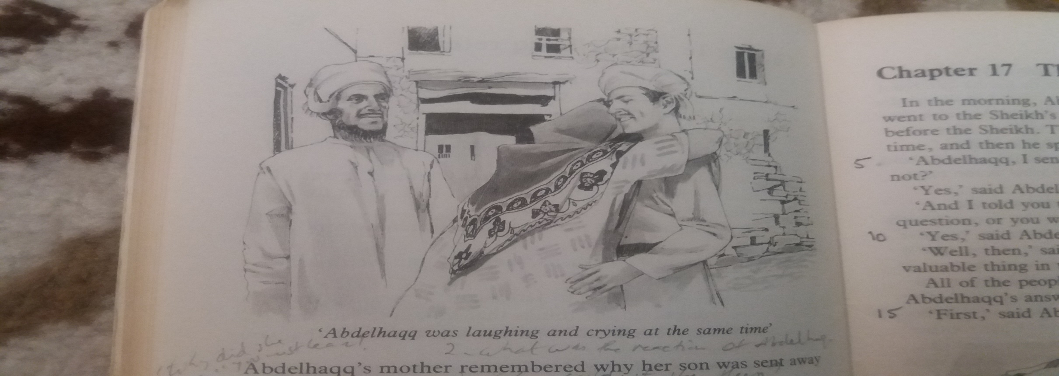
CHAPTER SIXTEEN
Abdelhaqq and his friends hadn’t got much money, but they bought a very nice “ Ihram” for Abdelhaqq, and quite cheaply too. Then all three had to work to get some more money.
Abood and Othman were very good workers,
and very clever at making things. Abdelhaqq helped them, and after a few days they had enough money to go to a guide and join his group
of pilgrims who were ready to go to Mecca.
They left Jiddah the next evening. They travelled at night and followed the Wadi Fatima for
part of the way.
They arrived in Mecca on the sixth day of
Dul Hijja. There, they joined the hundreds
of thousands of pilgrims.
In this way, they found the greatest
Happiness in their lives.
Abdelhaqq Returns

Slide 54
Five days later, Abdelhaqq, Abood and Othman, went together through the streets of Mecca
for the last time. Abood and Othman had decided to go on and visit the Holy Mosque
in Jerusalem, but Abdelhaqq was ready to go
to his home in Haradh. He was going to travel with pilgrims who were returning to Kuwait.
When he said goodbye to Abood and Othman, it was like saying goodbye to his own father.
He sat with them for a time in Mecca.
“ Did you find the thing that you were searching for?” he asked them.
Othman spoke first. “ Perhaps,” he said,
“ but we think we must go on searching.”
“ Abood said, “ We shall go to Jerusalem.
It was our father’s idea and we want to do
the things that he wanted to do. What about you, Abdelhaqq? Did you find the things
that you were searching for?”
“ I found a piece of it,” said Abdelhaqq.
“ But it is the most important piece. It is
the piece that completes the answer that
I shall give to our Sheikh in Haradh.”
“ Allah bring you safely home,”
said the brothers as they left.
“ Allah guide you,” said Abdelhaqq.
Then, he began his long journey to Haradh.
As far as Riyadh, he travelled with the pilgrims who were returning to Kuwait.
At Riyadh, he left them and completed the last seven days of the journey alone.
Can you imagine how he felt when he saw
his home again? Can you imagine how his parents felt when they saw their son again? His mother put her arms round him as if
she would never let him leave her again. There were tears in his father’s eyes. Abdelhaqq was laughing and crying
at the same time.
That night, the whole family sat down
to eat together and there was happiness
in every heart. But at the end of the meal the mother remembered why her son was sent away from Haradh. She remembered the question that he must answer or die.

Slide 55
His mother tried to make him leave, but he would not listen. All night,
she lay awake and cried.
The father comforted her and said, “Our son has changed. I Think he
has discovered something. Let us go
with him to the Sheikh in the morning and hear his answer to the question.”
She knew that if he left his home in Haradh again, her heart would break, but she said,
“ My son, before tomorrow you must leave Haradh and go to a safe place. If you stay here, you will die.. Nobody knows the
right answer to the question that
the Sheikh gave you.”
“ Mother, “ said Abdelhaqq, “ tomorrow,
I shall stand before the Sheikh and tell him what I have discovered during my journeys.. And then, if I die, I die, but I shall not
die like an animal.”

Slide 56

CHAPTER SEVENTEEN
In the morning, Abdelhaqq, his mother and his father
went to the Sheikh’s house. Abdelhaqq was brought
before the Sheikh. The Sheikh looked hard at him
for a long time, and then he spoke.
“ Abdelhaqq, I sent you away from Haradh
a year ago, didn’t I ?”
“ Yes, “ said Abdelhaqq.
“ And I told you to come back with the right
answer to a question, or you would die
like an animal, didn’t I ?”
“ Yes, “ said Abdelhaqq.
“ Well, then, “ said the Sheikh, “ speak !
What is the most valuable thing in the world?”
All the people in the house moved nearer
to hear Abdelhaqq’s answer. His mother
almost stopped breathing.
“ First,” said Abdelhaqq, “ Let me say this.
I shall die, as all men must die, perhaps even today, because not one of us knows when
Allah may call him.”
The Answer

Slide 57
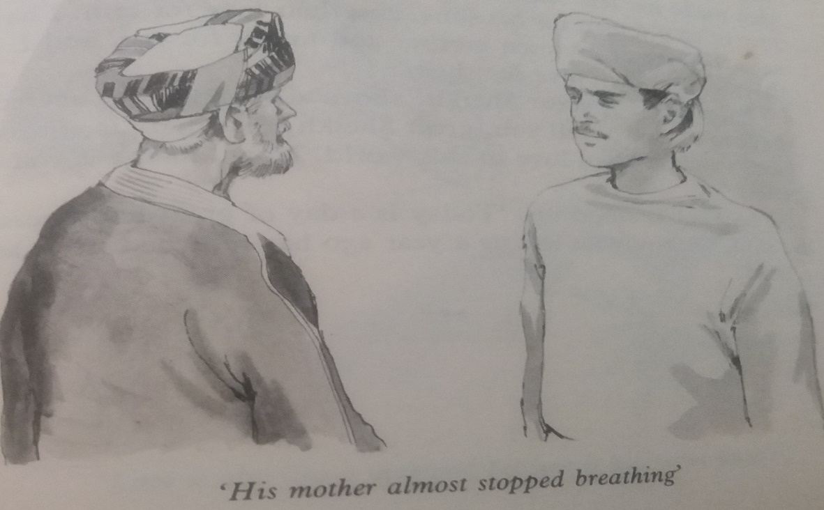
“ Great Sheikh,” said Abdelhaqq, “ the answer is : LOVE.
“ A wise old woman told me that love is worth
more than the largest diamond. And she
was right, because no one can buy love. But, it is also like a diamond, because it has many faces.
During the past year, I have seen the love of men for their fellow-men : when I nearly died of thirst,
the Beduin saved my life and took me to a man
who looked after me.
I have seen a woman with a love for her husband
that no one could break. I have seen a girl with
a love of her brother that made me feel shame for
my own fear. I have seen the love of an old man
for his two sons, and their love for him.
I have seen the love of my mother and
father for me, and I have felt my
own love for them.”
“ But above all, great Sheikh, above all,
I have discovered the love of Allah. I tell you,
great Sheikh, that there is nothing more
valuable than love in this world.
Now, kill me if you have to.”
“ Each of us got his life from Allah, and when
Allah calls me I am ready. But I shall not die like
an animal. I have stood on Jebel Arafat on the ninth
day of Dul Hijja, and I have opened my heart to Allah. This, an animal can never do, so I shall not die
like an animal.”
The Sheikh smiled. “ A good answer, my son,”
he said, “ and a true one, too, but you have not told
us what is the most valuable thing in the world.”

Slide 58
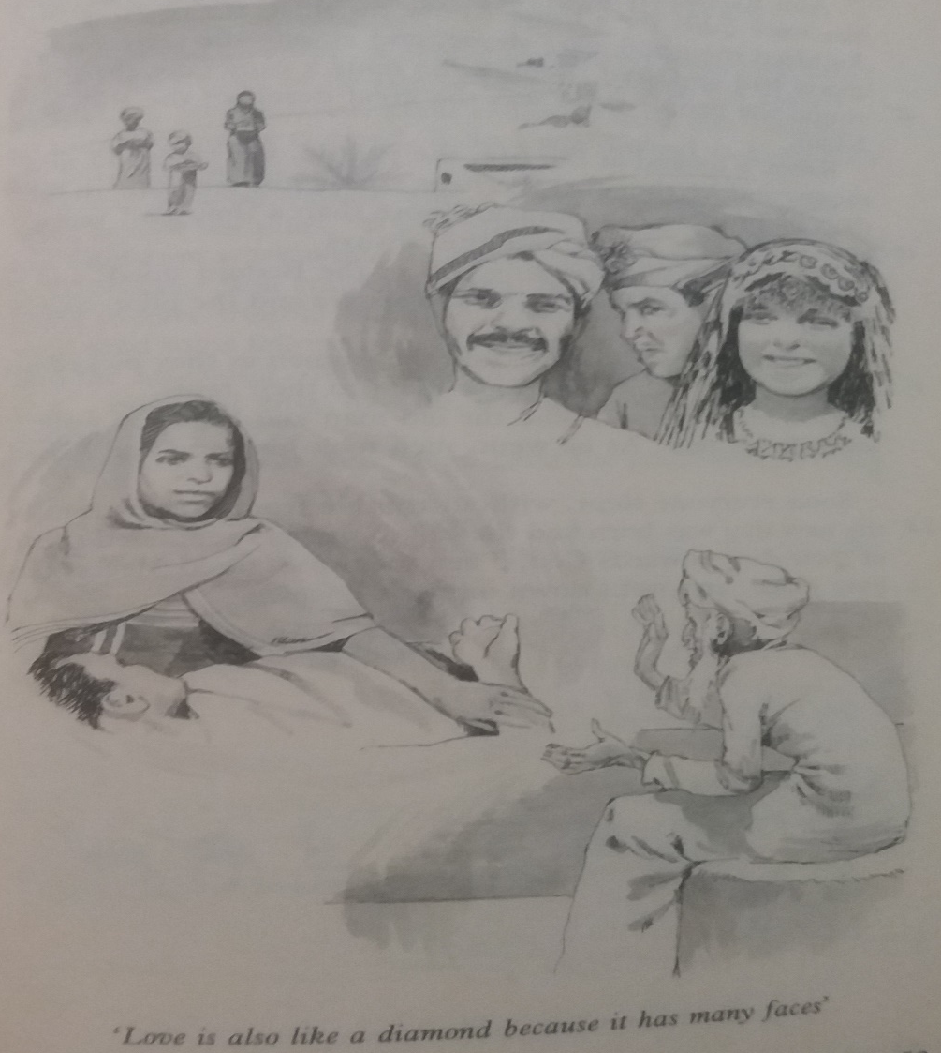
The Sheikh stood up.
“ Today is a day of great happiness,”
he said,
“ a boy who left us a year ago has returned to us
as a man.”
Hamad looked at the fire, the people, the stars and
new moon, and he thought, “ Perhaps it was just like
this in the days of our Prophet, more than thousand years ago.
Perhaps it will always be just like this.”
As Abu Khalid stood, all of the Beduin stood, and
so did Hamad and his brothers and sisters and the pilot
“ Allah Bless the old man,” said the women as they
picked up their sleeping babies to take them to their tents.
“ Allah Bless you all,” said the old man and began
walking towards his tent. The men took his hand
and kissed it.
Soon, everyone was asleep, without trouble from dreams, until the new day was born and the call to Prayer
reminded them of their duty towards Allah. Then,
they rose, faced Mecca, the holy place,
and went down on their knees.
Abu Khalid stopped speaking. The people round
the fire were quiet for a time. Above them, in the black
sky, a hundred thousand stars shone, and among
the stars, a new moon had appeared. Behind the tents,
a camel coughed. All round people there was the great desert of the Rub El Khali.

Slide 59
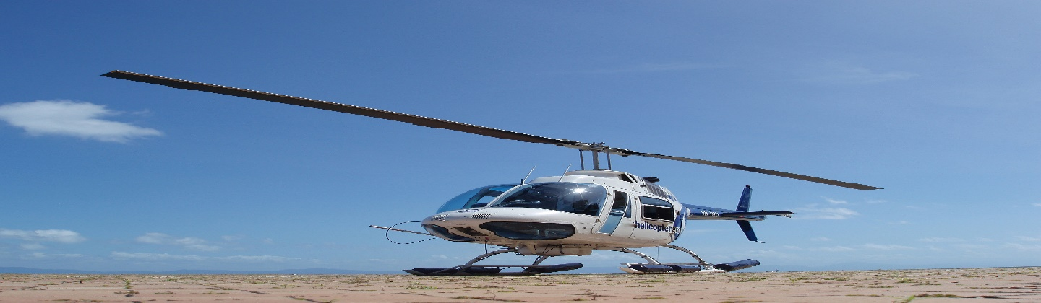
CHAPTER EIGHTEEN
Later in the morning, a helicopter arrived from Shaybah , and the loud voice of its engine brought fear to the camels and babies.
As it landed, great clouds of sand rose into the air until the engine stopped.
A door was opened and two men got out – big well-fed men.
“ Where’s Saood Faysal?” one of them shouted, and then, when he saw the pilot, “ Where are those tools, Saood? We’ve lost
four days work while we were waiting
for them. Is your radio broken? Will you
look at that plane ! Man, we are surely
going to have trouble when we try to move that. Ok, then, we’ll send some fellows over for it later. Let us get those tools into the helicopter. Where are those children for Muscat? OK, boys and girls, let us go,
let us go. Come on now. Move yourselves !”
The LAST CHAPTER
The Helicopter Arrives

Slide 60
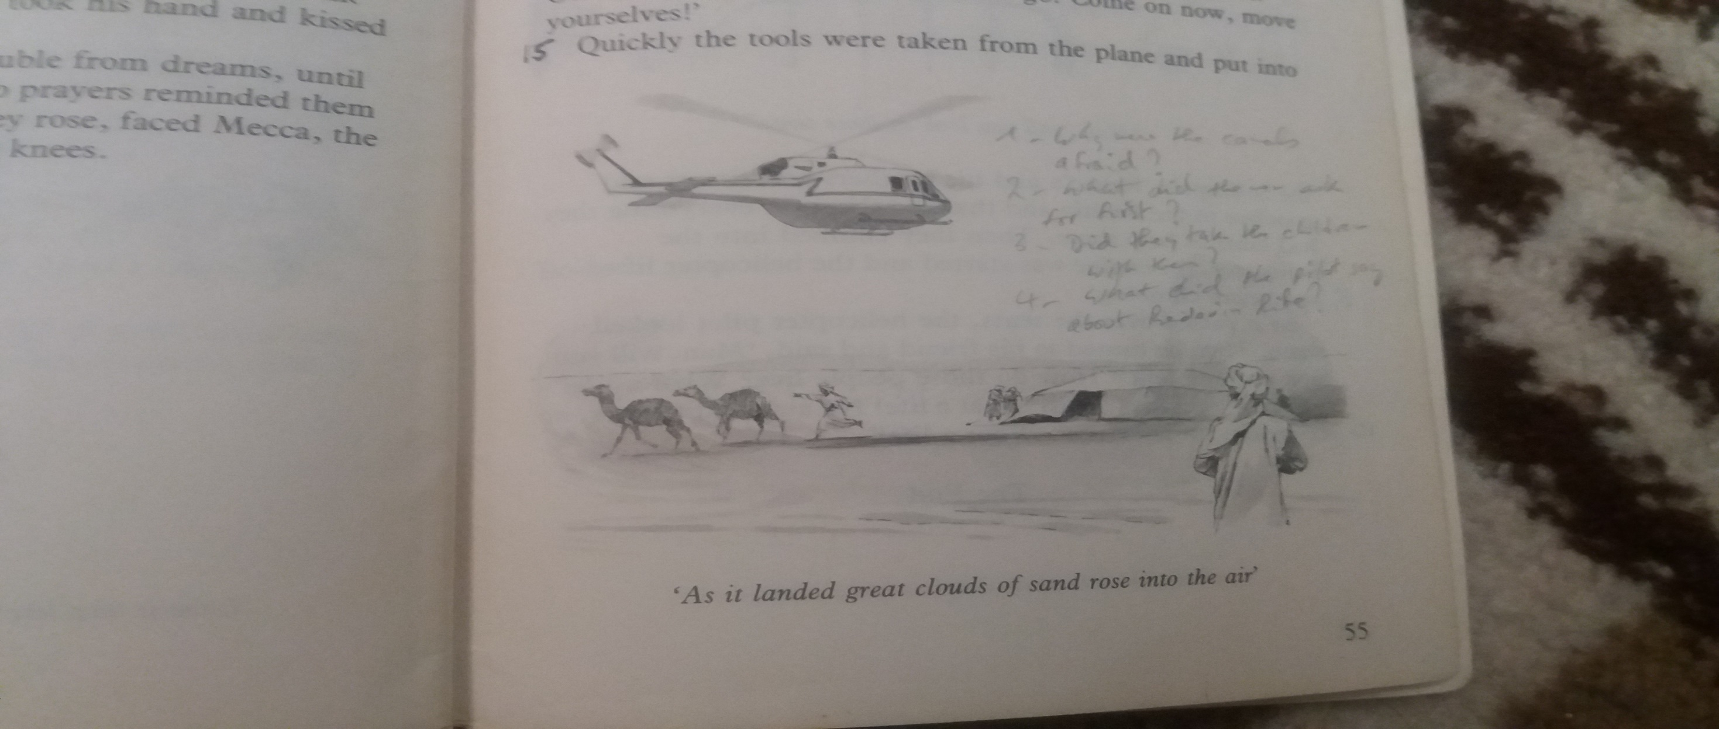

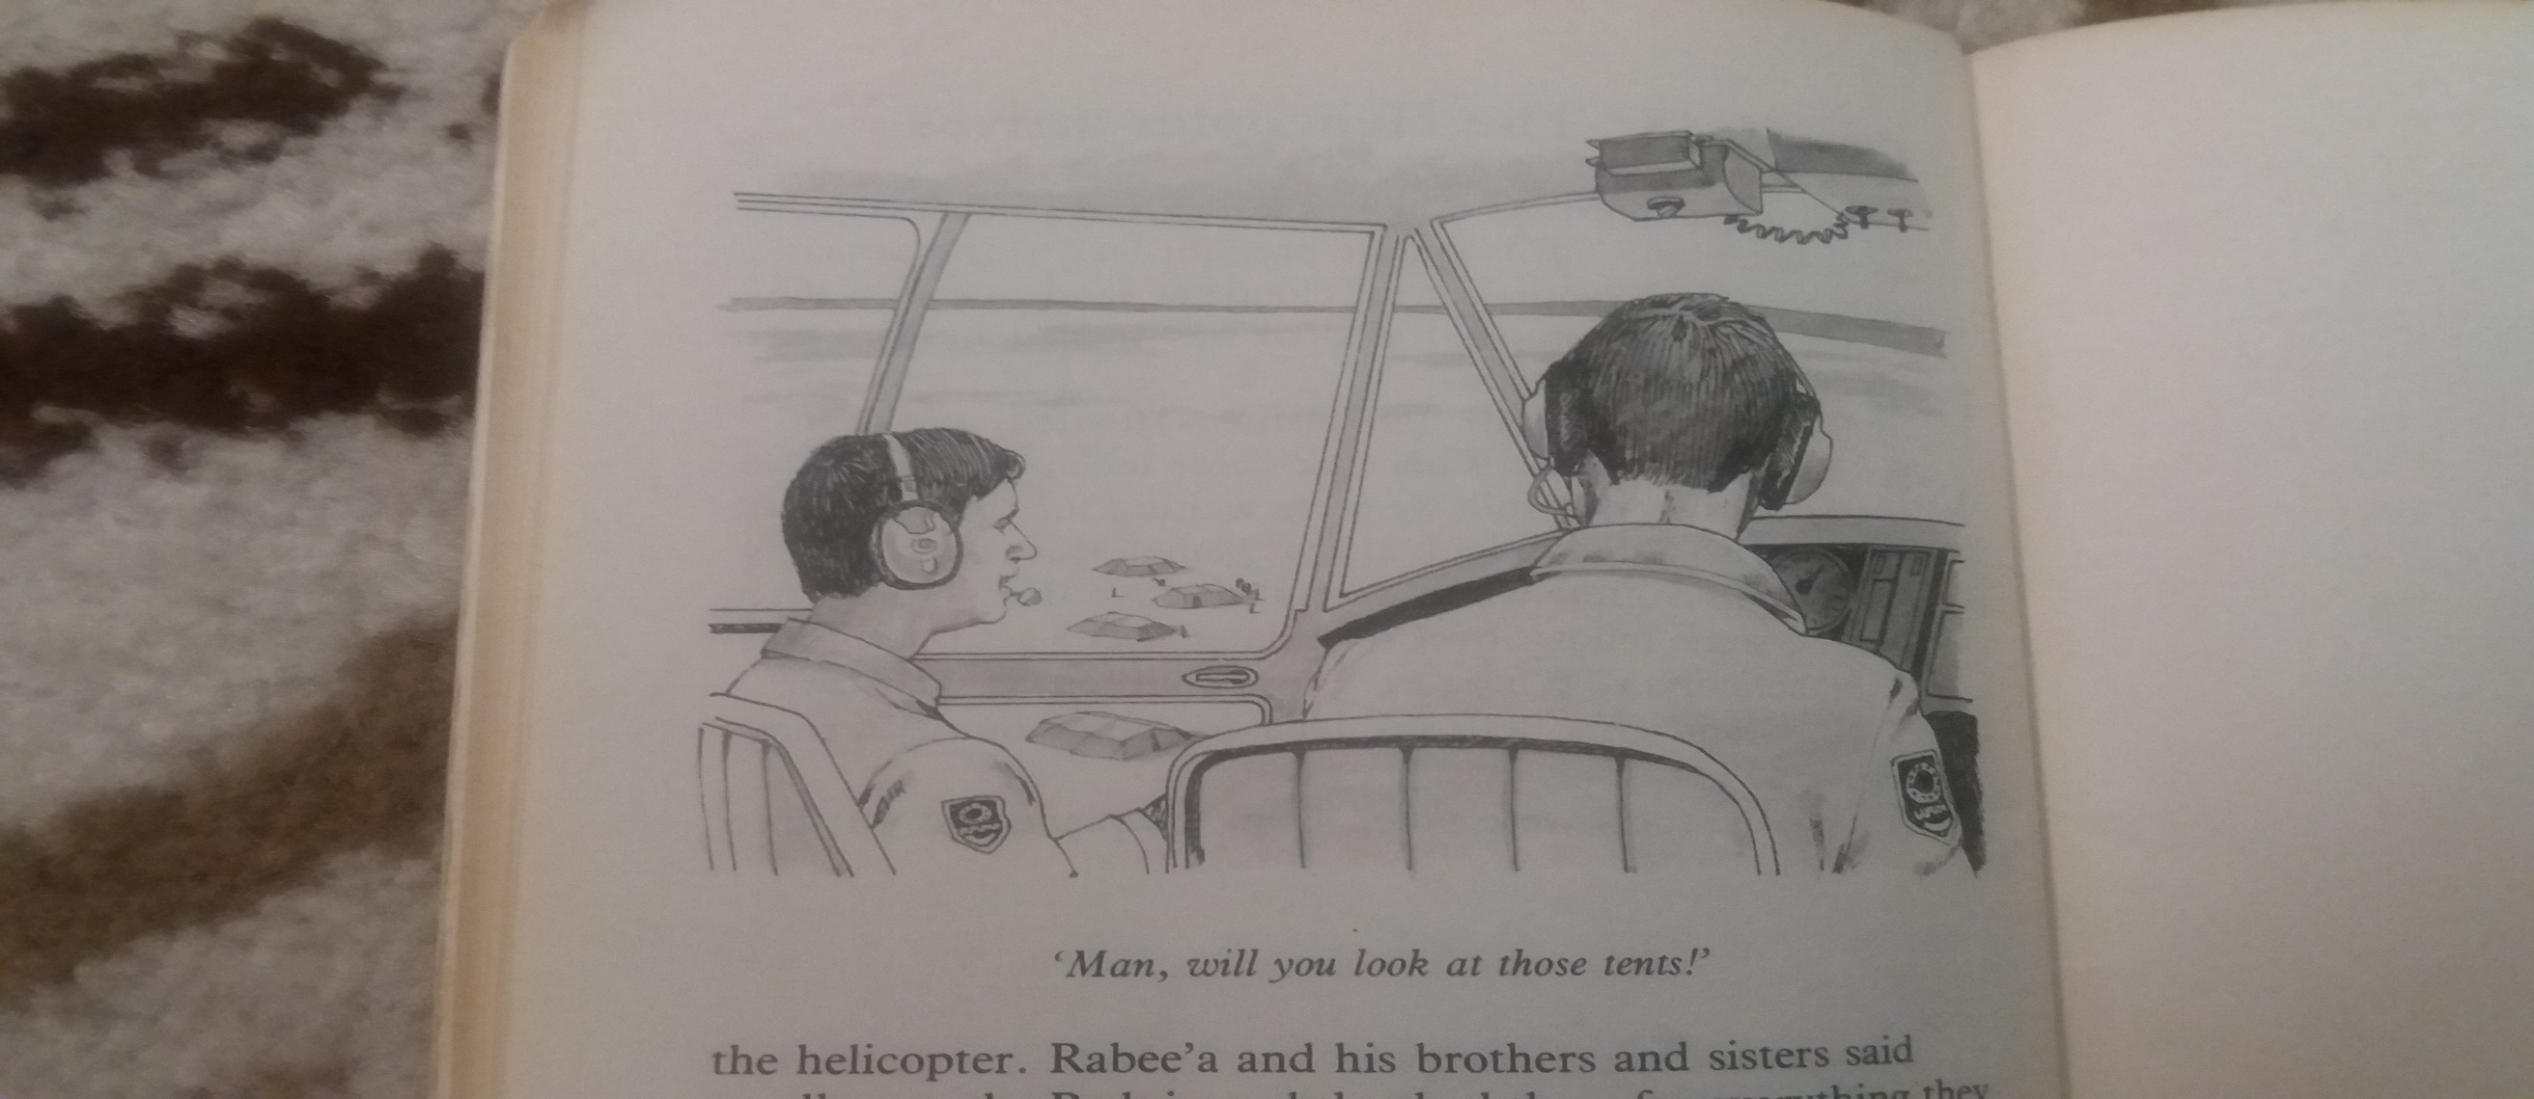

As the helicopter passed over the tents, the helicopter pilot looked down.
Then he turned to his friend and said, “ Man, will you look at those tents !”
Quickly the tools were taken from the
plane and put into the helicopter.
Hamad and his brothers and sisters said goodbye to the Beduin and thanked them
for everything they had done to help them.
Then, they climbed into the helicopter.
The engine was started and the helicopter lifted-off and began climbing into the sky.
“ How do these people live? What a life !”
“ Yeah,” said his friend, “ What a life ! No AC, no ice-cream, no TV. What a life !”
THE END

